Slide 1
Applying AI, NLP, and Optimization to COVID-19
November 12, 2020
The session starts at 9:00am.

Slide 2


Applying AI, NLP, and Optimization to COVID-19
IBM Analytics
Power of data. Simplicity of design. Speed of innovation.
Asad Mahmood
Bernie Beekman
Lee Angelelli
Michael Cronk
Prithvi Rao
© 2020 IBM Corporation

Slide 3
Introduction - Applying AI and Analytics to CoVID-19
Situation: COVID-19 virus is causing global deaths and socioeconomic instability
Problem: People scared about their livelihood; they have disengaged in economies and society
Challenges in collecting/analyzing information about COVID-19 and its impacts at speed and scale
Difficult to understand the diverse local/national populations’ health and psychological effects caused by COVID-19
Impacts: Lack of insight into current/future situation leading to non-optimal decisions/responses
Minimal insight into coronavirus spread, inaccurate demographic info about infections/symptoms
Peoples fears/needs, overcrowded hospitals, and necessary financial response
Shutdown of economies, educational impacts, community unrest, uncontrolled deficits expanding, etc.
Need: Data-Driven environment supported by intelligent systems with capabilities to:
Collect structured/unstructured data, extract features, and create situational awareness
Understanding current/future (predicted) COVID-19 surges/resurges
Identify current/future problems, obstacles, and impacts on societies, economies, education, politics, etc.
Reason on massive amounts of data and decision criteria to improve human decision making
Generate optimized response(s) for localized areas while showing aggregated affects at the national level
Collect Info (Drivers)
Assess Current / Future Situations
Prioritize, Plan, and Respond
Monitor, Measure, Evaluate
Learn

Slide 4


Agenda
Time | Description
9:00am – 10:00am | Introduction to IBM Cloud, Watson Services, Watson Studio, and Decision Optimization
10:00am – 11:30am | Lab 1 – Develop pandemic and socioeconomic annotators to extract domain-specific information
11:30am – 12:00pm | Lab 2 – Create a knowledge management system (KMS), ingest data, train the KMS to generate knowledge, and analyze information to create a COVID-19 stability index
12:00pm – 12:30pm | Lunch
12:30pm – 1:00pm | Lab 2 – Create a KMS (continued)
1:00pm – 1:15pm | Lab 3 – Introduction
1:15pm – 2:30pm | Lab3 – Develop a COVID-19 Chatbot Assistant
2:30 pm – 2:45pm | Lab4 – Introduction
2:45pm – 3:30pm | Lab4 – Forecast COVID-19 outbreaks – find optimal ways to relocate sick people among areas
3:30pm – 3:45pm | Lab5 – Introduction
3:45pm – 4:45pm | Lab5 – Develop dashboards that display COVID-19 statistics
4:45pm – 5:00pm | Wrap up – Q&A
3
© 2020 IBM Corporation
© 2019 IBM Corporation

Slide 5
Training Session Goals
Through a series of labs – attendees will develop these capabilities that will enable planners to respond with speed at scale
Lab 1
Ingest/extract information from text to create knowledge
COVID-19 Social Media
Lab 2
Understand human language, concepts, tones, needs, etc. to inform planners
Analyze the information to create social health indexes
Knowledge Management Systems
Lab 3
Create 'chat-bots' that act on this knowledge to answer peoples' questions
Cognitive Assistants
Lab 4
Analyze current drivers to forecast future conditions
Create optimization models based on current/future conditions
ML & Optimization Models
Lab 5
Create visual COVID-19 dashboards
COVID-19 UIs

Slide 6
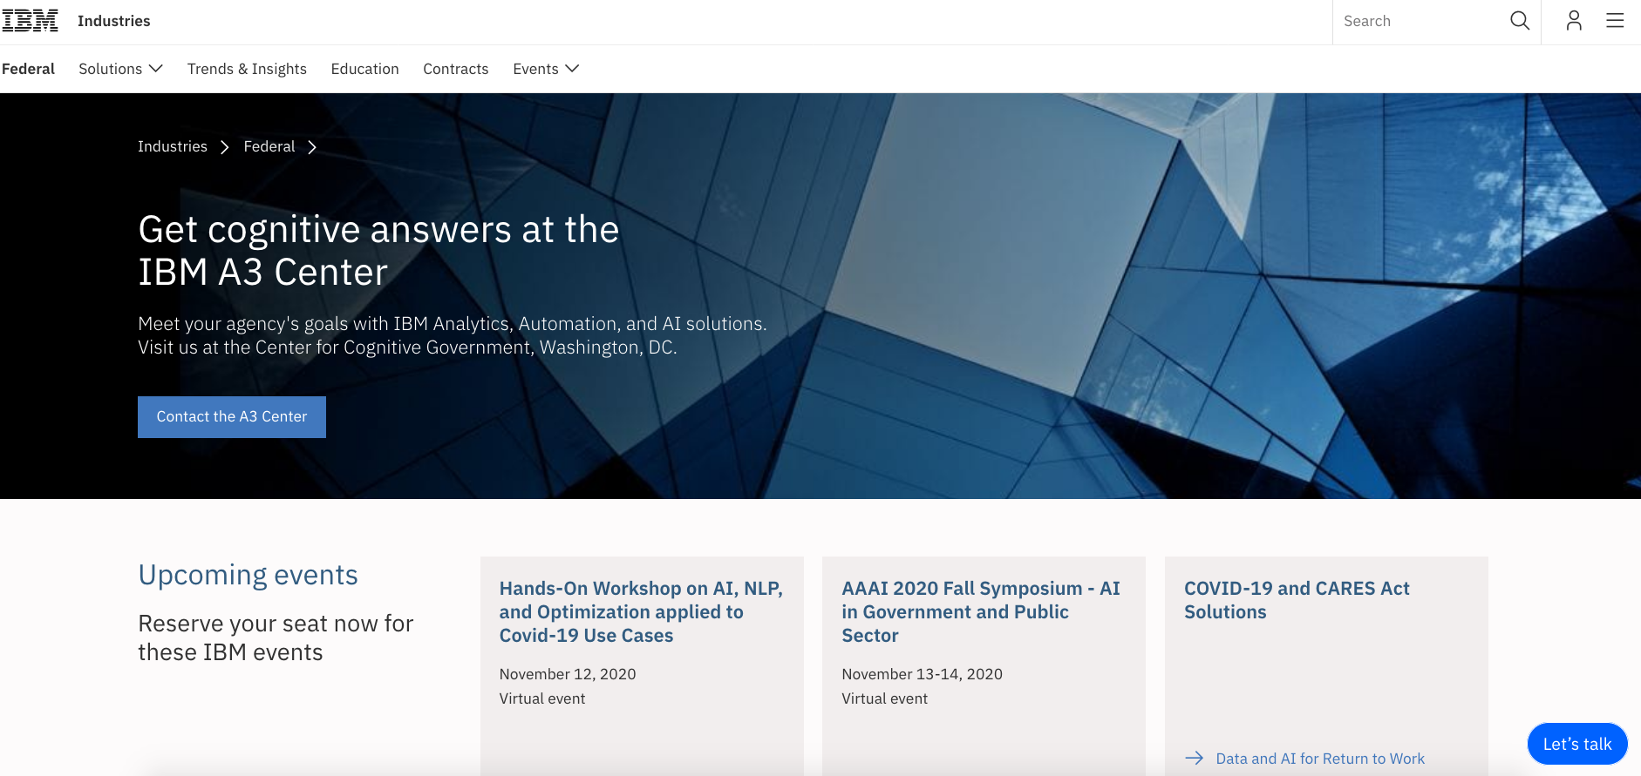
IBM A3 Center helping clients understand technologies and develop art-of-the-possible solutions

Slide 7
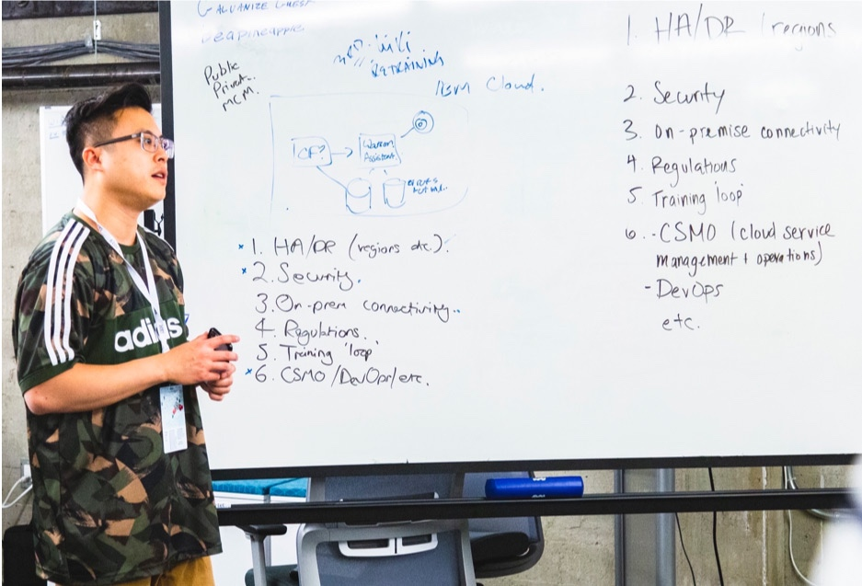



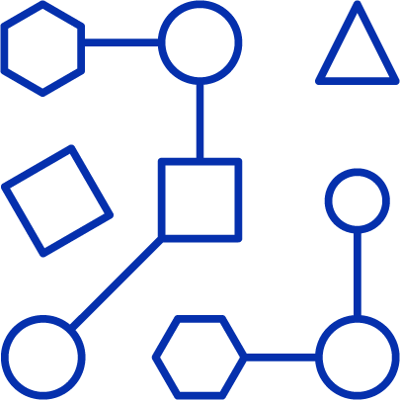

IBM Design Thinking Client Workshops
Please send your request for Design Thinking workshop to a3center@us.ibm.com
We use IBM Design Thinking to:
Solve complex problems in complex environments
Focus thinking on user experience
Encourage cross-function collaboration and fast iteration
Initial Framing Session
Frame your business issues as opportunities to test Validate path to handle challenges.
Design Thinking Session
Outline measures for success Identify challenges and inefficiencies Drill down into functionality and design to address challenges
Proof of Concept Build
Adopt DevOps Develop collaboratively Continuously deploy code
Notes:
Please send your request for Design Thinking workshop to

Slide 8
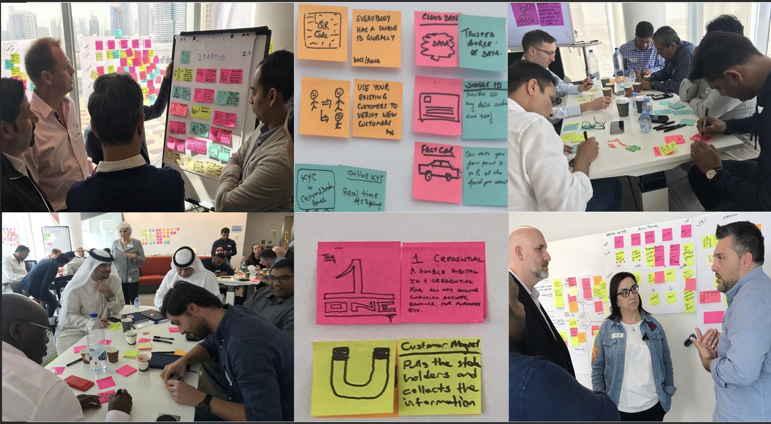
IBM Design Thinking Client Workshops – Sessions and Artifacts

Slide 9


Outline
IBM Cloud Overview
Watson Services Overview
Watson Studio Overview
Labs
9

Slide 10
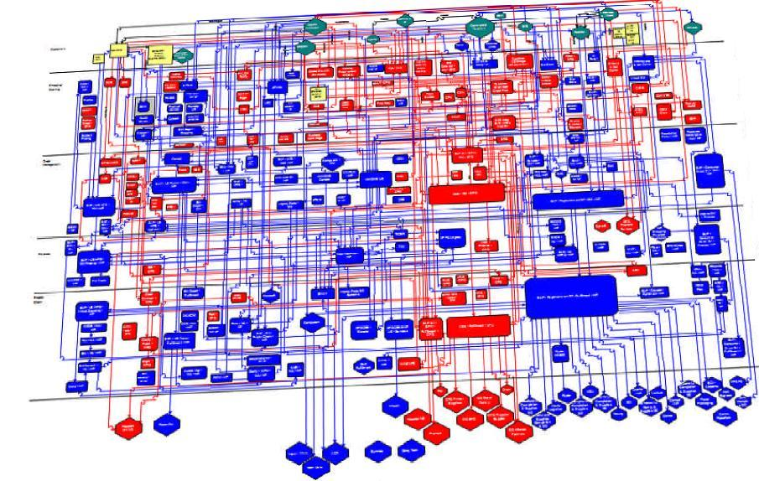
Drivers for Application Modernization in IBM Cloud
Current state constraints driving application modernization
Difficulty accessing data
Time to market challenges
Application modernization is improving the state of many things
Decades of application evolution have produced multiple drivers for application modernization
Multiple modernization approaches are required to address each driver
Business and IT needs determine application modernization drivers
Difficulty integrating with modern technologies
Constrained business
processes
Current State Application Portfolio
High operational costs and capacity limitations
Compliance and regulatory requirements
Skilled resource limitations
Limited application/technology knowledge

Slide 11
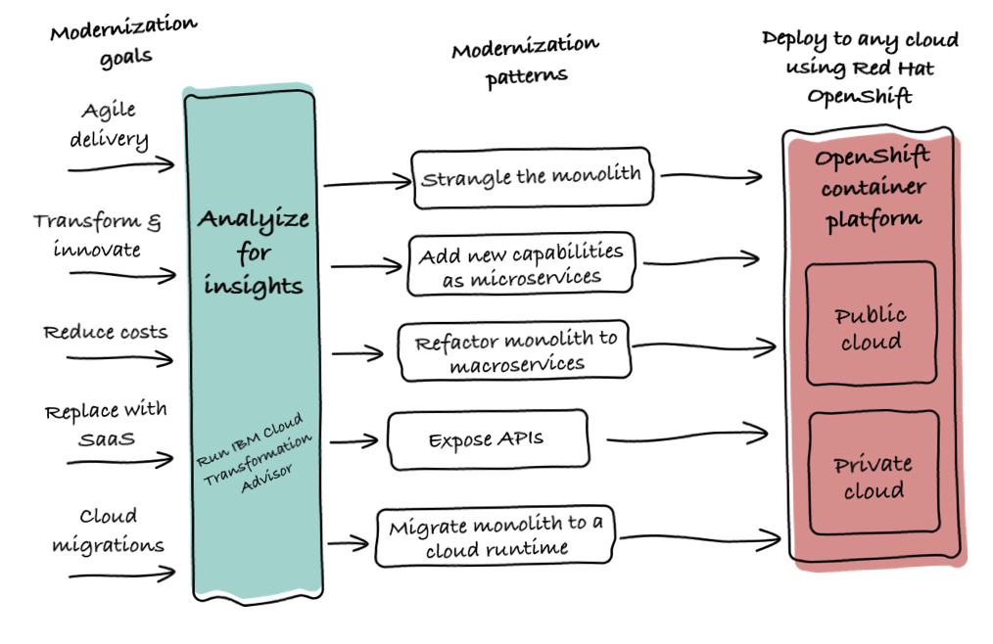
What is Modernization?
Containerize an Existing Application / Workload ?
Refactor Applications into Microservices ?
Strangle a over Monolith over time with new Microservices ?
Completely rewrite into new microservices ?
Automate deployment ?
Lift and Shift into a Cloud ?
Expose Applications through API’s ?
Augment Old Code with new microservices ? APIs / Services (AI, Data Science) ?
What About My Data !!!!!!!!
https://www.ibm.com/cloud/garage/content/field-guide/app-modernization-field-guide/

Slide 12

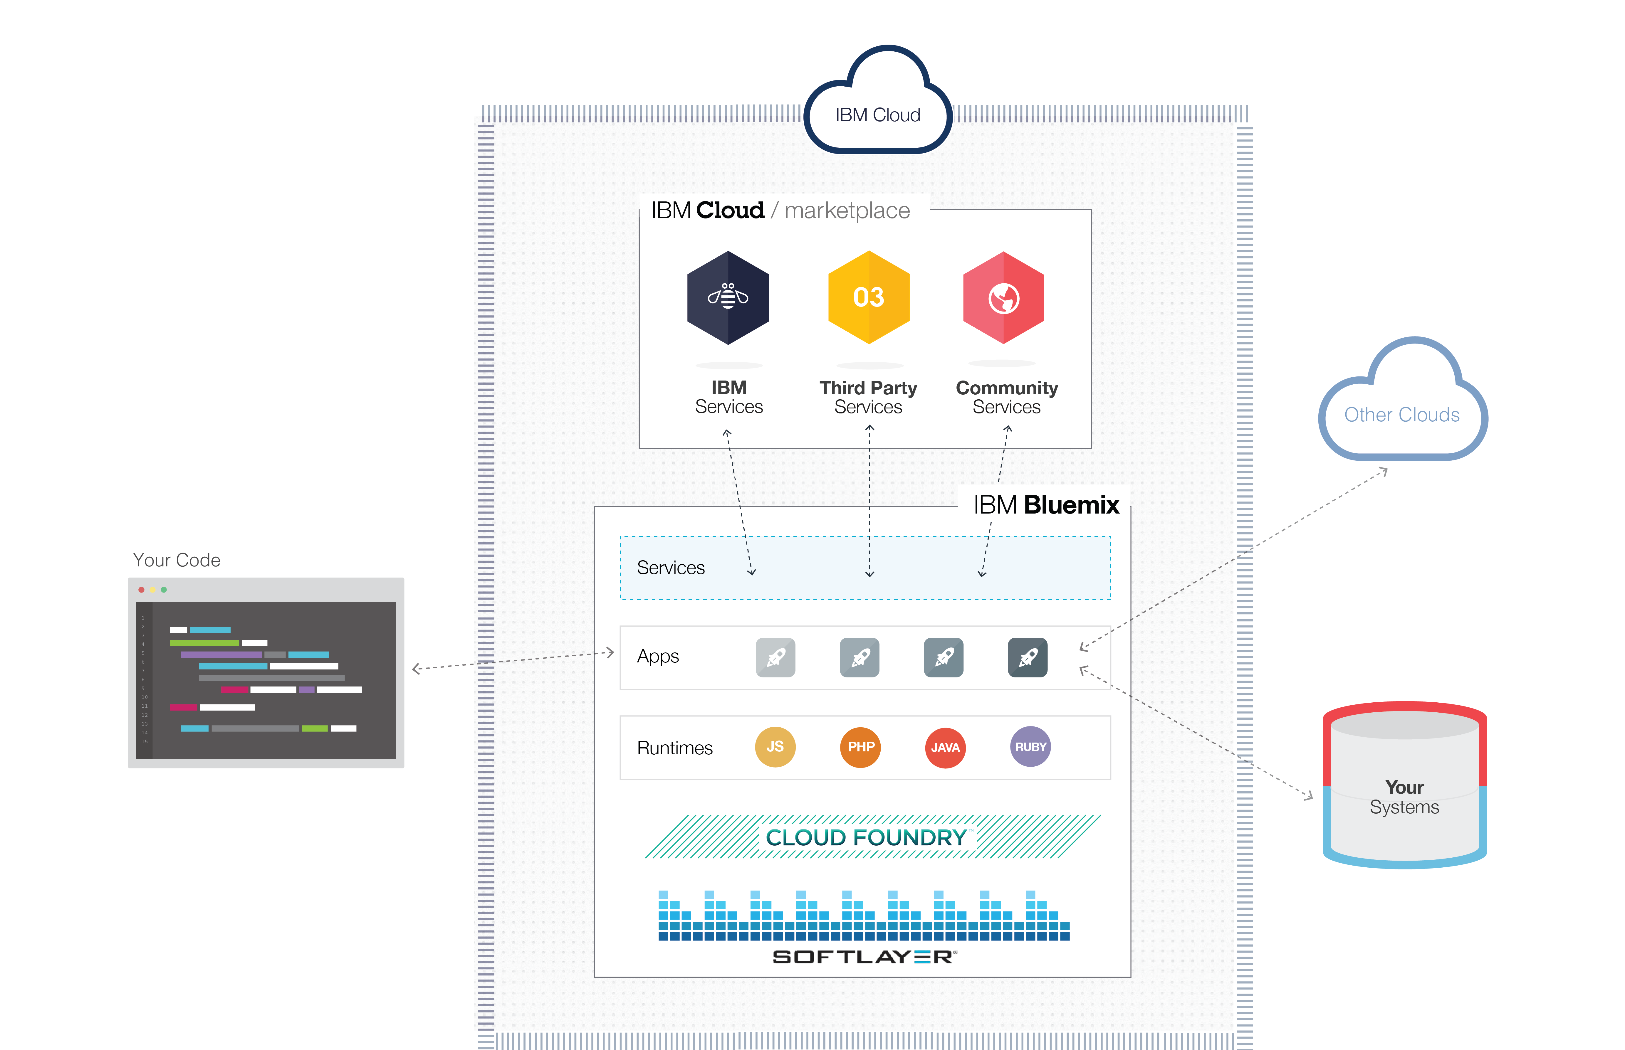















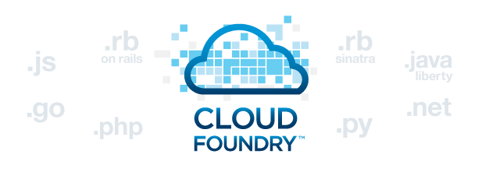



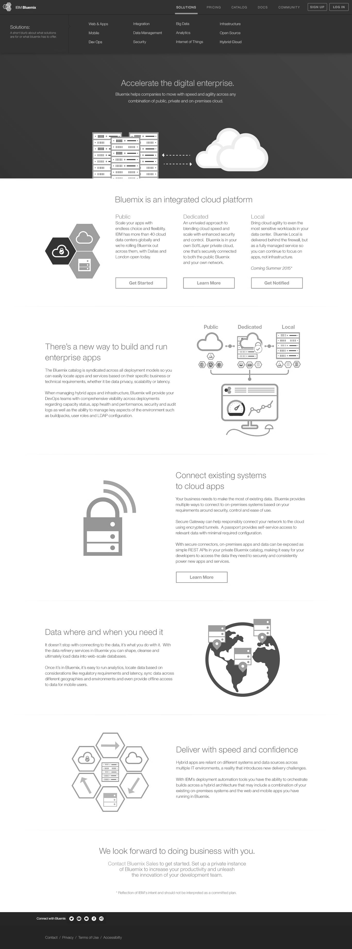
What is IBM Cloud?
DevOps
Tooling
Integration and API Mgmt
Your Own Hosted Apps / Services
Catalog of Services that Extend Apps’ Functionality
ENRICH
+
Web
Data
Mobile
Cognitive
Analytics
IoT
Security
Yours
EXPLORE
DEPLOY
Flexible Compute Options to Run Apps / Services
Functions
Instant Runtimes
Containers
Platform Deployment Options that Meet Your Workload Requirements
+
Cloud
Public
Cloud
Dedicated
IBM Cloud Paks
IBM Cloud Satellite
+
Powered by IBM Cloud Infrastructure
In Your Data Center
Instant Environments
The developer can choose any language runtime or bring your own. Zero to production in one command.
APIs and Services
A catalog of 125+ IBM, third party, and open source API services allow the developer to stitch an application together in minutes.
On-Prem Integration
Build hybrid environments. Connect to on-premise assets plus other public and private clouds.
Build your apps, your way
Use the most prominent compute technologies to power your app: Cloud Foundry, Docker, Kubernetes.
DevOps
Development, monitoring, deployment, and logging tools allow the developer to run the entire application.
Flexible Pricing
Sign up in minutes. Pay as you go and subscription models offer choice and flexibility.
12
Notes:
IBM Cloud allows you to Choose your own infrastructure, language, architecture, and make your own design choices
Push notification, messaging, no SQL
Production live coding, building, and deploying applications

Slide 13
Why Migrate/Modernize Applications to the IBM Cloud?
IBM Cloud: the most open and secure public cloud for business
Open Innovation
Best public cloud for open source, including OpenShift
Build and run apps with ease on managed Red Hat OpenShift on IBM Cloud
IBM Cloud runs its entire platform, including Watson & IBM Blockchain on Kubernetes (1k+ clients, 16k+ clusters in production)
Automated deployment of Cloud Paks and complex workloads with our schematics and infrastructure as a code offering.
IBM contributes to and operationalizes open source projects like Razee, Istio, Knative, and Eirini to provide clients a full portfolio of cloud native tools
Security Leadership
Market leading data protection across the platform
Highest industry compliance for data encryption
Configurable so that not even IBMers can see your data
Single dashboard threat management with IBM Security integration
Industry leader in container security
Enterprise Grade
Reliable foundation for enterprise workloads
#1 VMware public cloud
Cloud migration for Power AIX, IBMi, Z, SAP and mission critical
Broadest portfolio of secure compute choices: Bare metal, Virtual Private Cloud (VPC), virtual servers, containers, and serverless resources

Slide 14
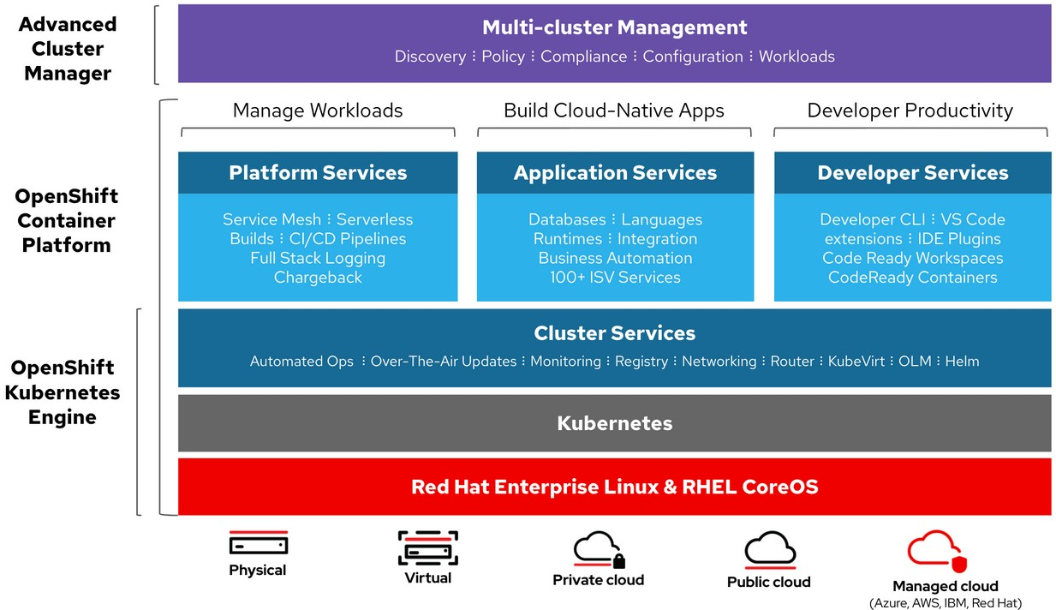
Red Hat OpenShift on IBM Cloud Capabilities
Simplified cluster
management
Design your
own cluster
Security
& isolation
Extend apps with IBM Cloud services
Native open-source
experience
Integrated
operational tools

Slide 15
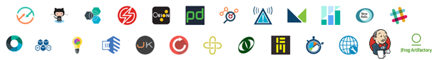

IBM Cloud DevOps Capabilities
Cloud.net/devops
Deliver to market with speed, control, confidence and compliance
Cognitive DevOps Insights
Continuous Delivery
Continuous Availability
Continuous Security
Speed with control
Always on
Automated ops
Protect & defend
Open Toolchain
8
Notes:
The Toolchain
Cognitive DevOps Insights – Dashboards & Analytics, Code Insights, Deployment Risk Insights, Delivery Insights
Continuous Delivery – GitHub Source & Issues, Continuous Integration & Delivery, Rolling Deploy & Rollback, Hybrid Cloud Release Mgmt
Continuous Availability – Monitoring, Alerting and Notification, Event Management, Runbook Automation
Continuous Security – Application Scanning, Penetration Testing, Vulnerability Advisor, Patching
Open Tool Chain Fabric – Tool Registry, Templates, Setup & Configuration, Tool Integration Services

Slide 16
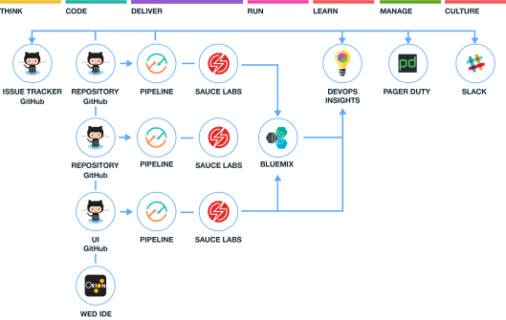

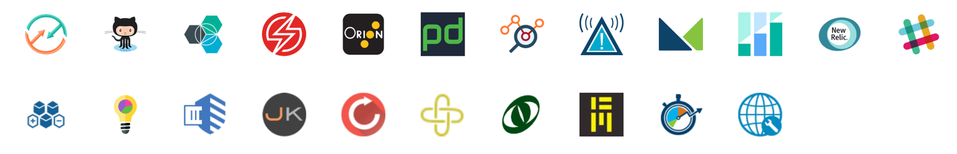
Built on the Open Toolchain foundation
A sample open toolchain for building, and deploying and managing three microservices
Toolchains provide an integrated set of tools that support the best practices to build, deploy and manage your apps
You can create toolchains that include Cloud services, open source tools, and third-party tools that make development and operations repeatable and easier to manage
Rapidly instantiate new toolchains from templates to on-board new teams quickly
Notes:
The concept of Toolchain made real, and open
Elements
Tools – Orion Web IDE, Delivery Pipeline, Git Repos & Issue Tracking, DevOps Insights
Tool integrations – Slack, PagerDuty, Sauce Labs, Jenkins, Jira, Artifactory, Nexus, SonarQube, …
Templates – Tool patterns plus sample code
SDK – Coming soon

Slide 17
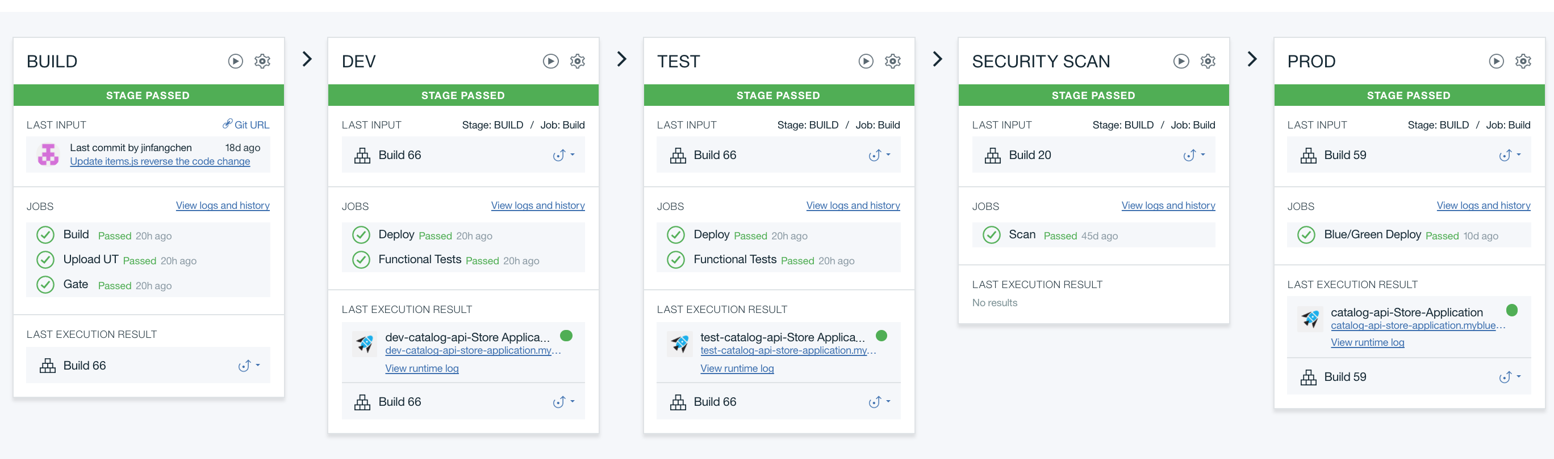
Deliver Continuously using an Integrated Pipeline
Import Code
Import, build, and deploy an application from a GitHub repository in a few clicks
Continuous Integration
Automate builds and deployments for many types of code, running builds automatically when code changes
Continuous Testing
Drive automated unit tests, function tests, security scans, and more; with quality gates
Deliver to Multiple Platforms
Deploy applications to Cloud Foundry, Cloud, IBM Containers, other clouds, or on-premises systems
Notes:
Cloud SaaS tool
Build, Deploy, Integrate, Test, continually
Numerous build, test, deploy job types
Jobs run in isolated containers

Slide 18

Five key principles define IBM’s approach…
Five Key Principles Define IBM’s Approach…
1
Hybrid
Enable enterprises across Public, Private, and traditional environments
2
Multicloud
Manage other vendors’ Clouds, acknowledging the reality that client environments are heterogeneous
3
Open
Build capabilities that are open by design, enabling client flexibility and reducing vendor “lock in”
4
Secure
Provide reliability and continuous security for the client’s environment
5
Management
Consistent service level, support, logging, management & delivery across complete cloud environments
Delivered by a composable cloud platform that is uniquely…
Multimodal (VM, Containers, Bare metal, Serverless)
Multiarchitecture (x86, Power, IBM i, AIX, IBM Z)
IBM Cloud Platform
Addressing both Enterprise and Hyperscale workloads

Slide 19
Cloud Paks – Accelerate your journey to cloud
Enterprise-ready, containerized software solutions that give you an open, faster, more secure way to move core business applications for any cloud
Complete yet simple Application, data and AI services, fully modular and easy to consume
IBM certified Full software stack support, and ongoing security, compliance and version compatibility
Run anywhere On-premises, on private and public clouds, and in pre-integrated systems
IBM containerized software
Packaged with Open Source components, pre-integrated with the common operational services, and secure by design
Operational services Logging, monitoring, metering, security, identity access management, image registry
Container platform Kubernetes-based and portable
Pre-integrated Systems
*Source: http://ibm.biz/Ovum-WP

Slide 20


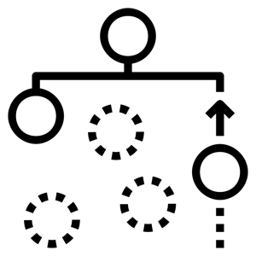

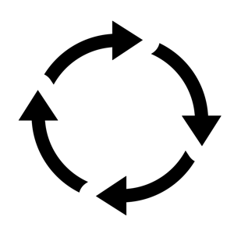












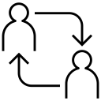



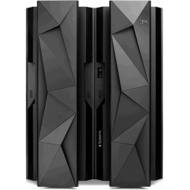
Cloud Paks – Pre-integrated for cloud use cases
Today, IBM offers clients the first six Cloud Paks…
Cloud Pak for Applications
Cloud Pak for
Data
Cloud Pak for Integration
Cloud Pak for Automation
Cloud Pak for Multicloud Management
Cloud Pak for Security
Developer & DevOps Tools
Modernization
Toolkit
Organize
Analyze
API Lifecycle
Messaging
and Events
Content
Operational
Intelligence
Multicluster
App and Infrastructure
Federated
Search and Investigation
Incident Response
Frameworks and Runtimes
Collect
App and Data Integration
Workflow and Decisions
Security and Compliance Management
Security Orchestration and Automation
Container platform and operational services
Container platform and operational services
Container platform and operational services
Container platform and operational services
Container platform and operational services
Container platform and operational services
AWS
MS Azure
Google Cloud
IBM Cloud
Edge
Private
Systems

Slide 21
Cloud Paks on IBM Cloud
Integrated with IBM’s public cloud, leveraging RedHat OpenShift on IBM Cloud
IBM Cloud Pak for Applications
IBM Cloud Pak for Data
IBM Cloud Pak for Integration
IBM Cloud Pak for Automation
IBM Cloud Pak for Multicloud Management
Build and modernize on a cloud platform explicitly architected for workload and data portability.
Move those securely with Bring Your Own Key, Level 4 FIPS, and built-in industry compliance including PCI, HIPAA, GDPR, SOC1 and SOC2.
Leverage a managed OpenShift that directly integrates into the same Kubernetes service that maintains 25,000+ clusters and 250 billion on-demand forecasts daily at The Weather Company.
Enjoy push-button integrations with IBM and Red Hat middleware and cloud services through IBM Cloud Schematics and IBM Cloud Content Catalog.
Compute isolation choices including bare metal worker nodes.
Managed OpenShift offering with HA masters, multizone clusters, and 99.99% SLA.
IBM public cloud

Slide 22
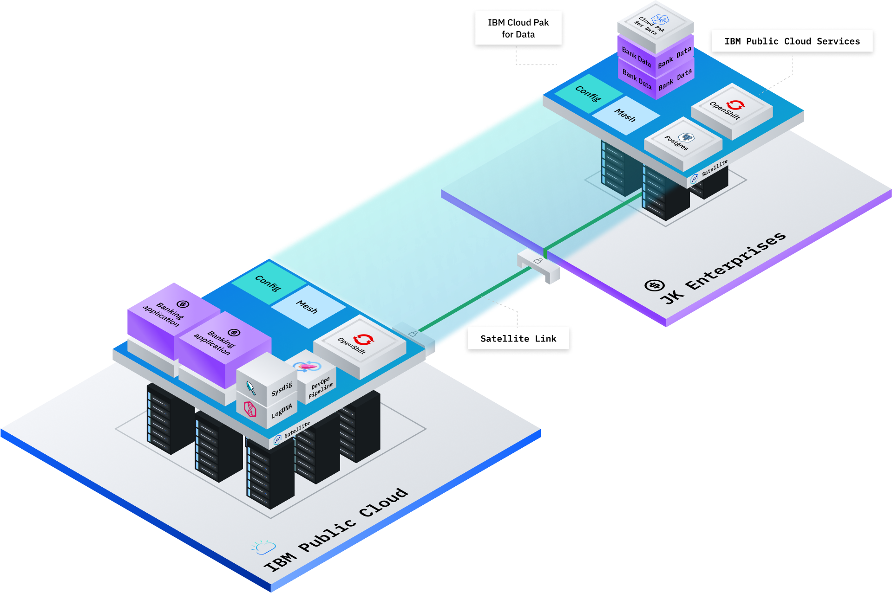
What is IBM Cloud Satellite?
IBM Public Cloud Extended to Customer Infrastructure
IBM Cloud services anywhere a client needs them, delivered as-a-service from a single pane of glass controlled through the public cloud.
Benefits
Achieve consistency & app performance across distributed cloud environments
Enables IBM Cloud-managed services at client locations
End to end security where data & workload reside
Reduces management cost

Slide 23




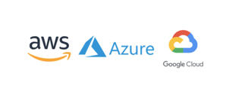
IBM Cloud Services, Cloud Paks, & Client Workloads on
Client Defined Infrastructure
Cloud Pak
…
Cloud Pak
Client Applications
…
Client Applications
…
IBM Public Cloud Services
Satellite
Satellite Managed Hosts
BYO Infra
IBM GTS IaaS
IBM Cloud
IBM CloudPak System
Edge
Hyperscalers
Notes:
GTS:
Integration with Private Managed IaaS Offerings. Satellite provides GTS a cloud managed set of PaaS capability on top of their IaaS offering. GTS provides Satellite a fully-managed on-premises IaaS layer. Enables IBM to deliver an end-to-end SLA and Compliance for Satellite. Integration with MCMP•MCMP + Satellite provides SRE managed IBM cloud services driven by the common user experience of MCMP•MCMP acts as the broader Multi-cloud management story incorporating both CP4MCM and Satellite. MCMP would include Satellite integration by default in its offering
Cloud Pak System:
Cloud Pak system is being rebooted as a Red Hat stack in a box. RHEL, RHEV, and OCP. Working to preinstall Satellite on Cloud Pak System, enabling a simple model where a system becomes a cloud in a box managed by Satellite. Power on the box, log into IBM Cloud, Box becomes an Satellite location automatically. This would give us an AWS Outpost answer
Cloud Pak for Data -aaS:
SaaS flavor of the paks, but want to still offer the “run anywhere” capability. Satellite provides a common API and operational model to give the Cloud Pak teams the OpenShift platform, deployment and operations as a service on premises and in any public cloud. Starting with Cloud Pak for Data team as a first “white glove” adopter of Satellite. Satellite enables the Cloud Pak “1-click” install flow to work to any location, including on-prem

Slide 24
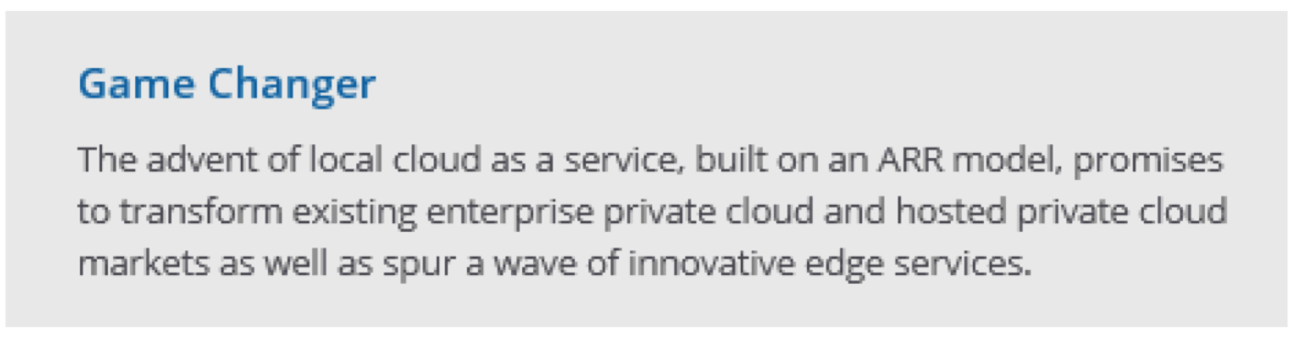
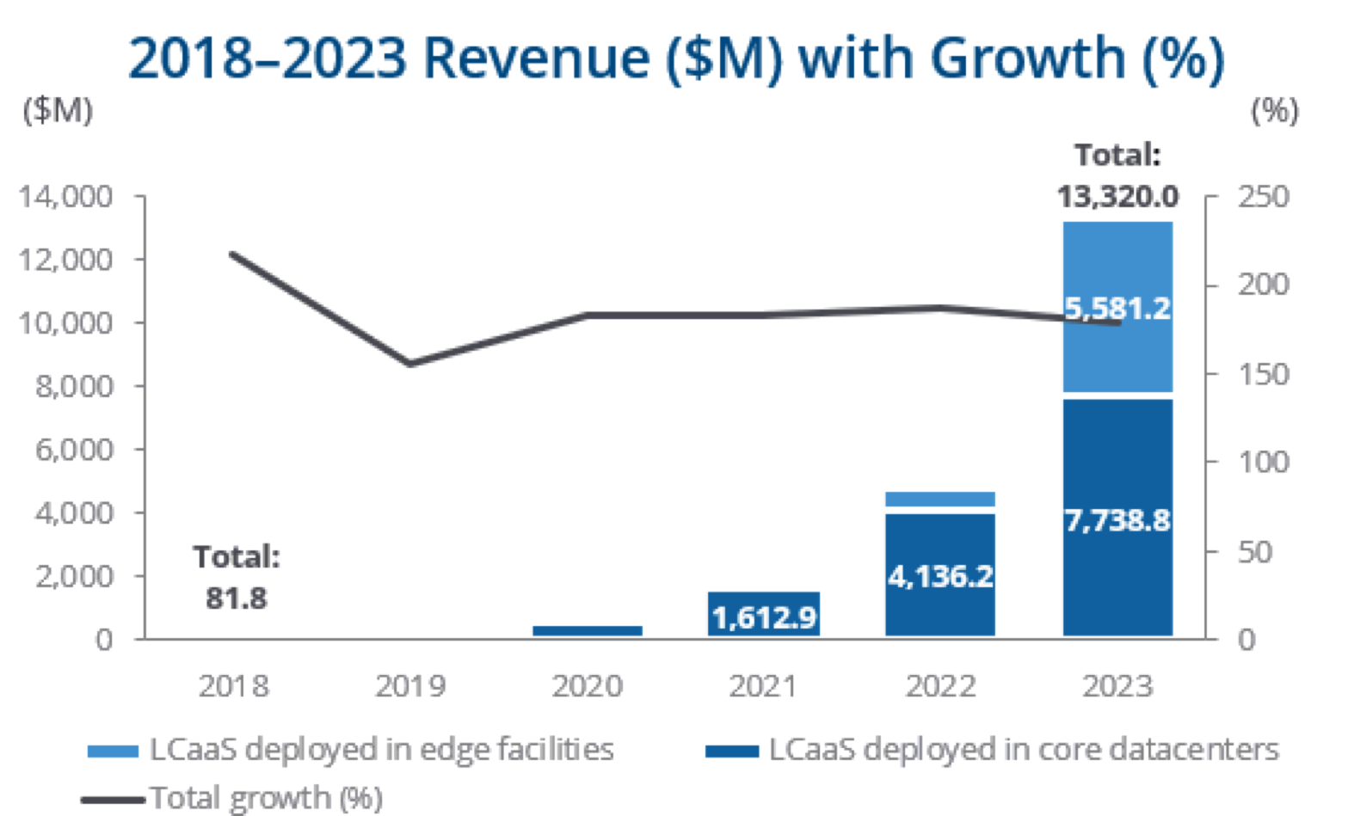
What Market Space is Satellite Part of?
Gartner defines the space as "Distributed Cloud"
“Distributed cloud is the answer to the question “What is the future of cloud computing?” It refers to the distribution of public cloud services to different physical locations while the operation, governance and evolution of the services remain the responsibility of the public cloud provider.”
IDC defines the space as "Local Cloud as a Service"
“Use of public cloud stacks for customer premises/dedicated infrastructure is expected to grow rapidly in the next 5 years, and will account for about 19% of all core shipments in 2023”
Core Competitors to Satellite Azure Arc, Google Anthos, AWS Outpost/Wavelength

Slide 25
Outline
IBM Cloud Overview
Watson Services Overview
Watson Studio Overview
Labs

Slide 26








IBM Watson AI Services
Use IBM AI capabilities to create cognitive systems that can:
Understand – understand human language
Reason - understand underlying concepts, forms hypothesis, and can infer based on present data
Learn - value increases over time as AI improve with each new piece of information and with each new interaction
Interact – the ability to talk, hear, and interact with humans in a natural way
Watson Application Services
Predict and shape future outcomes
Watson
Assistant
Watson
Discovery
Watson
Services
AI Digital Automaton
Optimize labor to higher value work
Next-gen Call Center
Case Management
Human Interaction
Knowledge Work
Compare & Comply
Automate decision, processes & experiences
Expert Assist
Behavioral Insights
Robotic Automation
Customer Experience
Voice of the Customer
Visual Recognition
Customer Mgmt.
Reimagine new business models
Build
Deploy
Catalog
Manage
Watson Services
Watson Assistant
Natural Language Understanding
Text-to-Speech
Compare & Comply
Watson Discovery
Tone Analyzer
Knowledge Studio
Natural Language Classifier
Personality Insights
Speech-to-Text
Language Translator
Visual Recognition
https://cloud.ibm.com/catalog?category=ai
Notes:
IBM Cloud provides services that enable a company to be data driven, create data insights, intelligent workflows, automate business processes to enable clients Digital transformation.
Clients who can migrate/modernize their apps to the cloud with
IBM provides AI Capabilities that reason, learn, and interact
Here’s a list of Watson services that enable apps to predict and shape…., Optimize…, Automate decision making, etc.

Slide 27
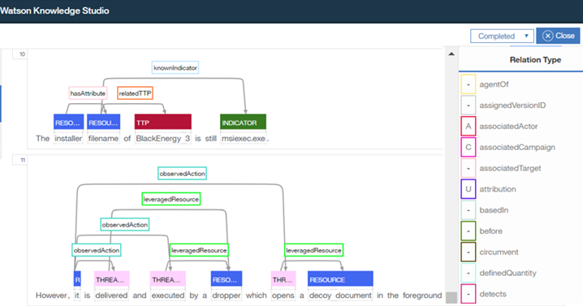

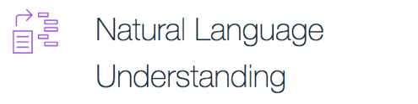
Watson Knowledge Studio
Create a machine learning model
Understands the linguistic nuances, meaning, and relationships specific to an industry
Create a rule-based model
Finds entities in documents based on rules that you define
Build models without requiring deep technical skills or coding
Apply curated model to multiple applications including Discovery and Assistant

Slide 28
WKS Annotation Example
Uses mention/relation detection and coreference to understand human language

Slide 29
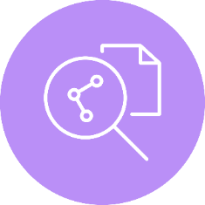
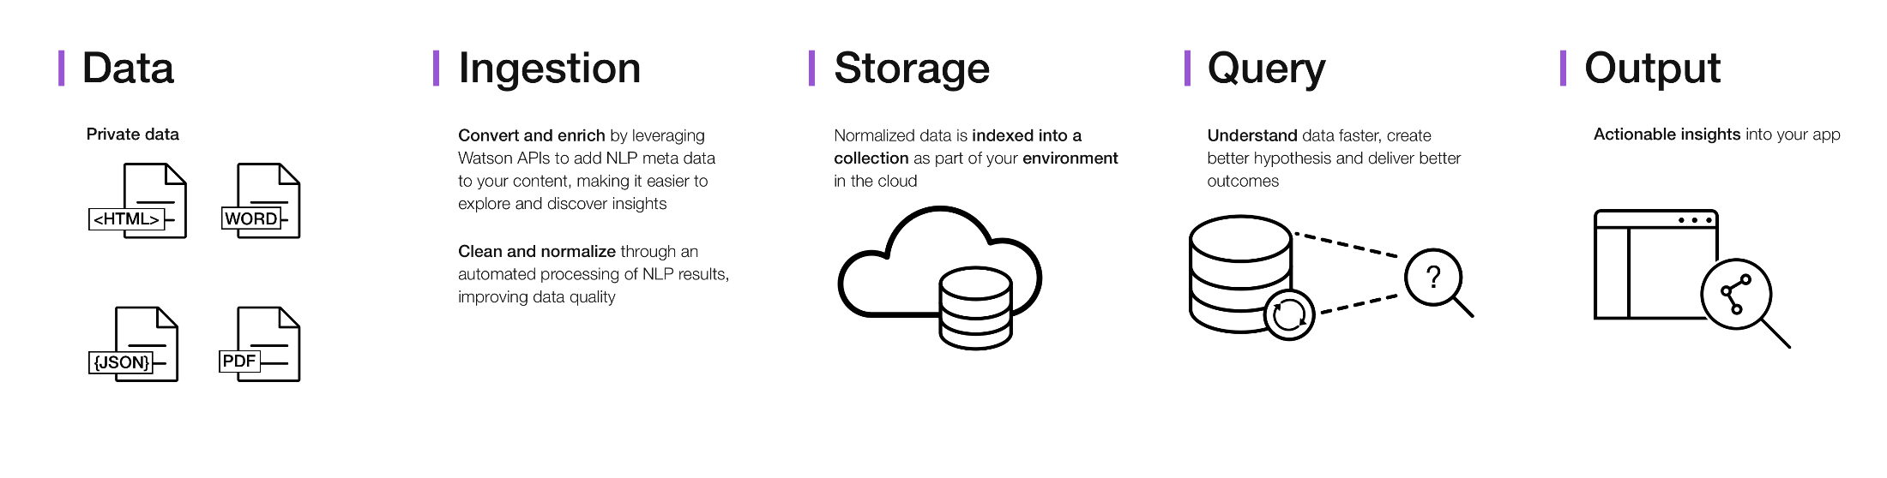
Watson Discovery Service
Rapidly add a cognitive search and content analytics engine to applications to identify patterns, trends and actionable insights that drive better decision-making
Automate Data Ingestion using the APIs, web upload or data crawler and feed through Document Conversion to deal with multiple file types
Apply enrichments to make the raw data ‘smarter’ with easy Natural Language Processing and custom models to extract entities, relations, keywords, sentiment, etc.
Combine Diverse Content Sources to create one-of-a-kind applications that leverage data from pre-enriched sources and private content from across the enterprise
Extract Insights with simple but powerful queries that support multiple query types including boolean, filter, and aggregation queries to discover patterns, trends and answers
Extend conversation apps to find answers without modeling intents
Notes:
Deepika
Let’s dig a little deeper into how Watson Discovery Service reduces developer friction at a high level:
* Automate how you can add data and convert it using automated data ingestion

Slide 30
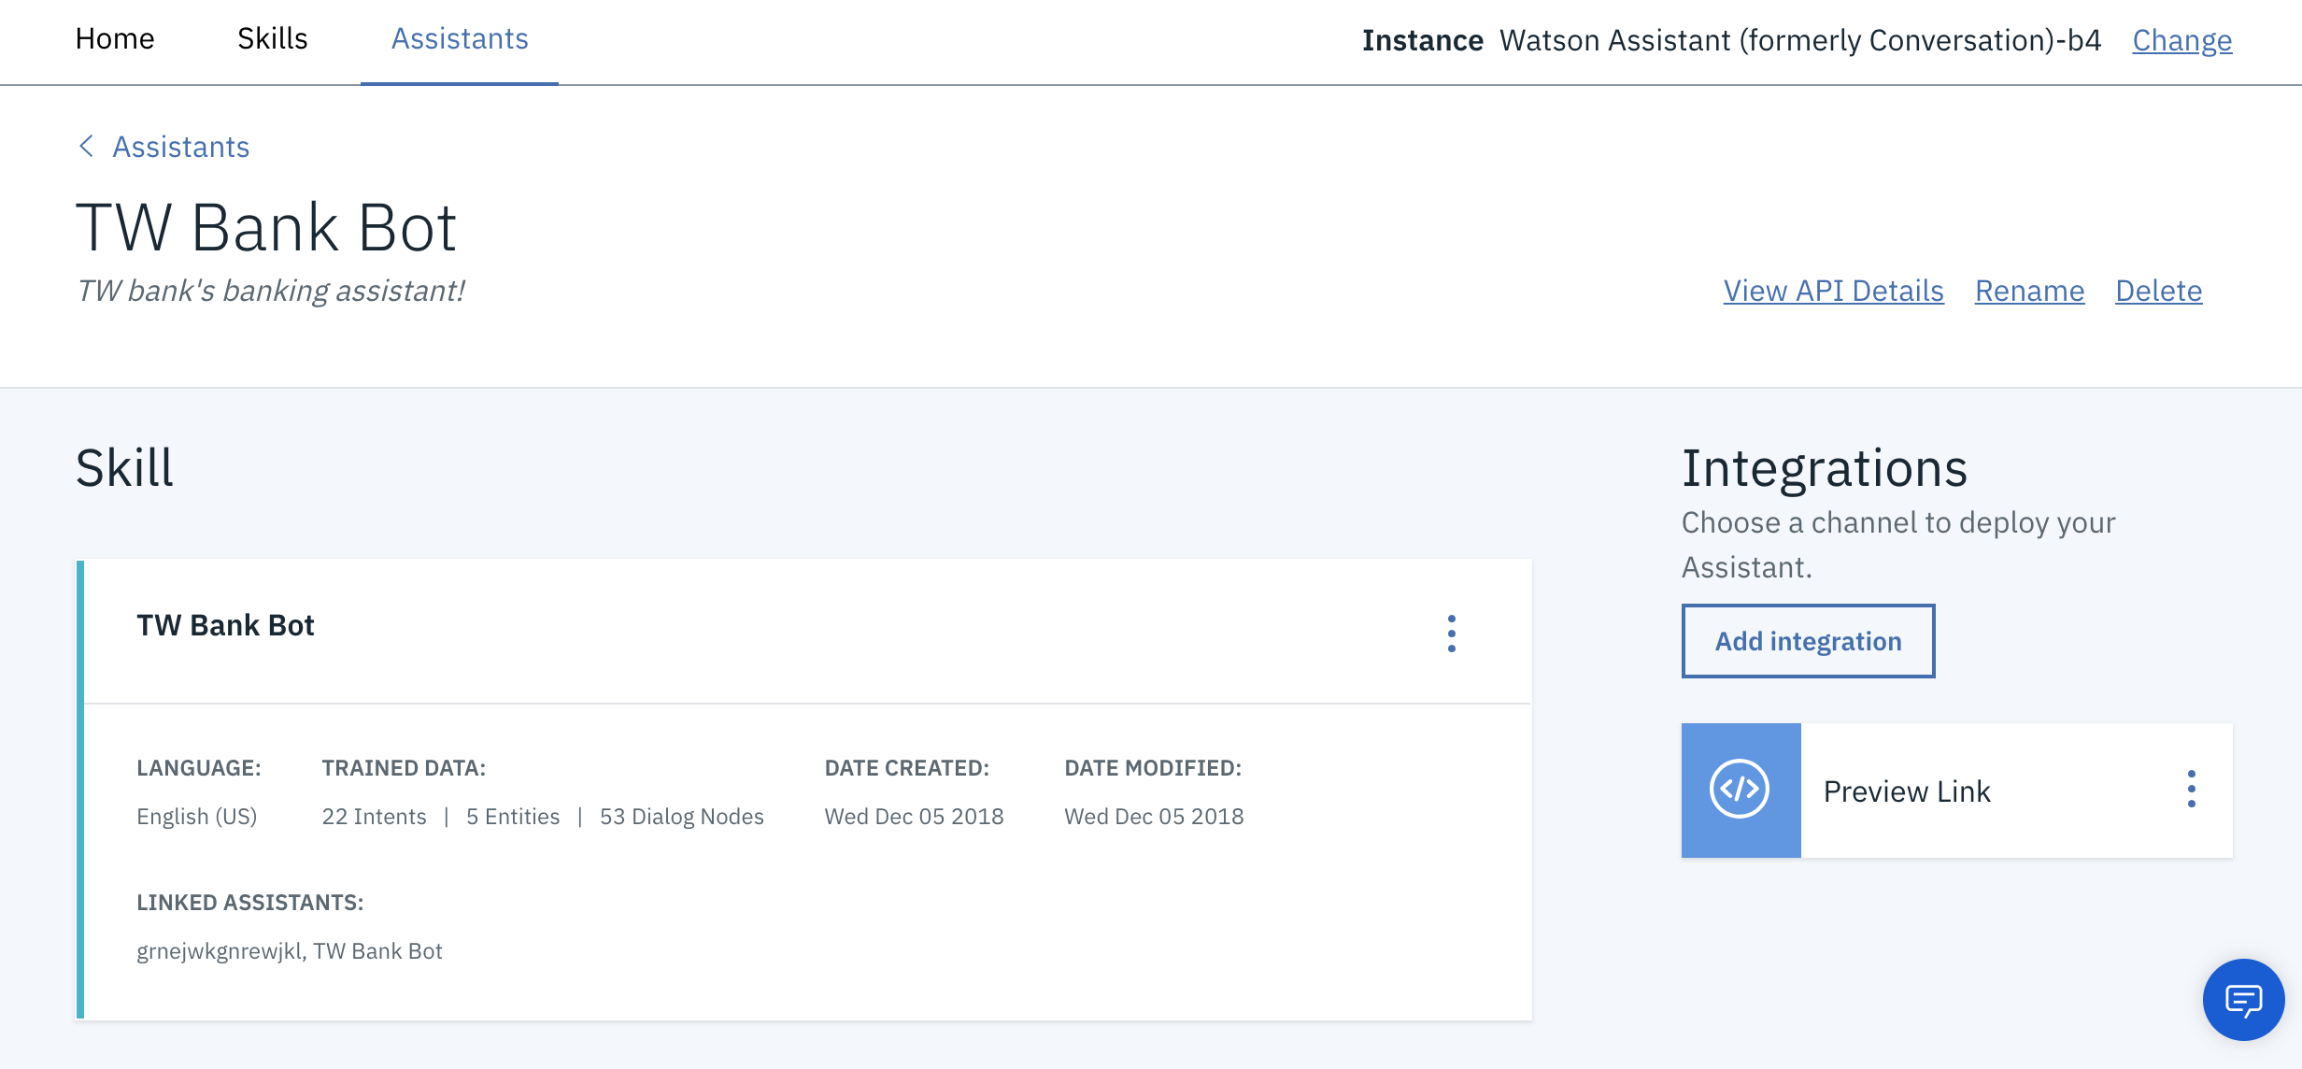
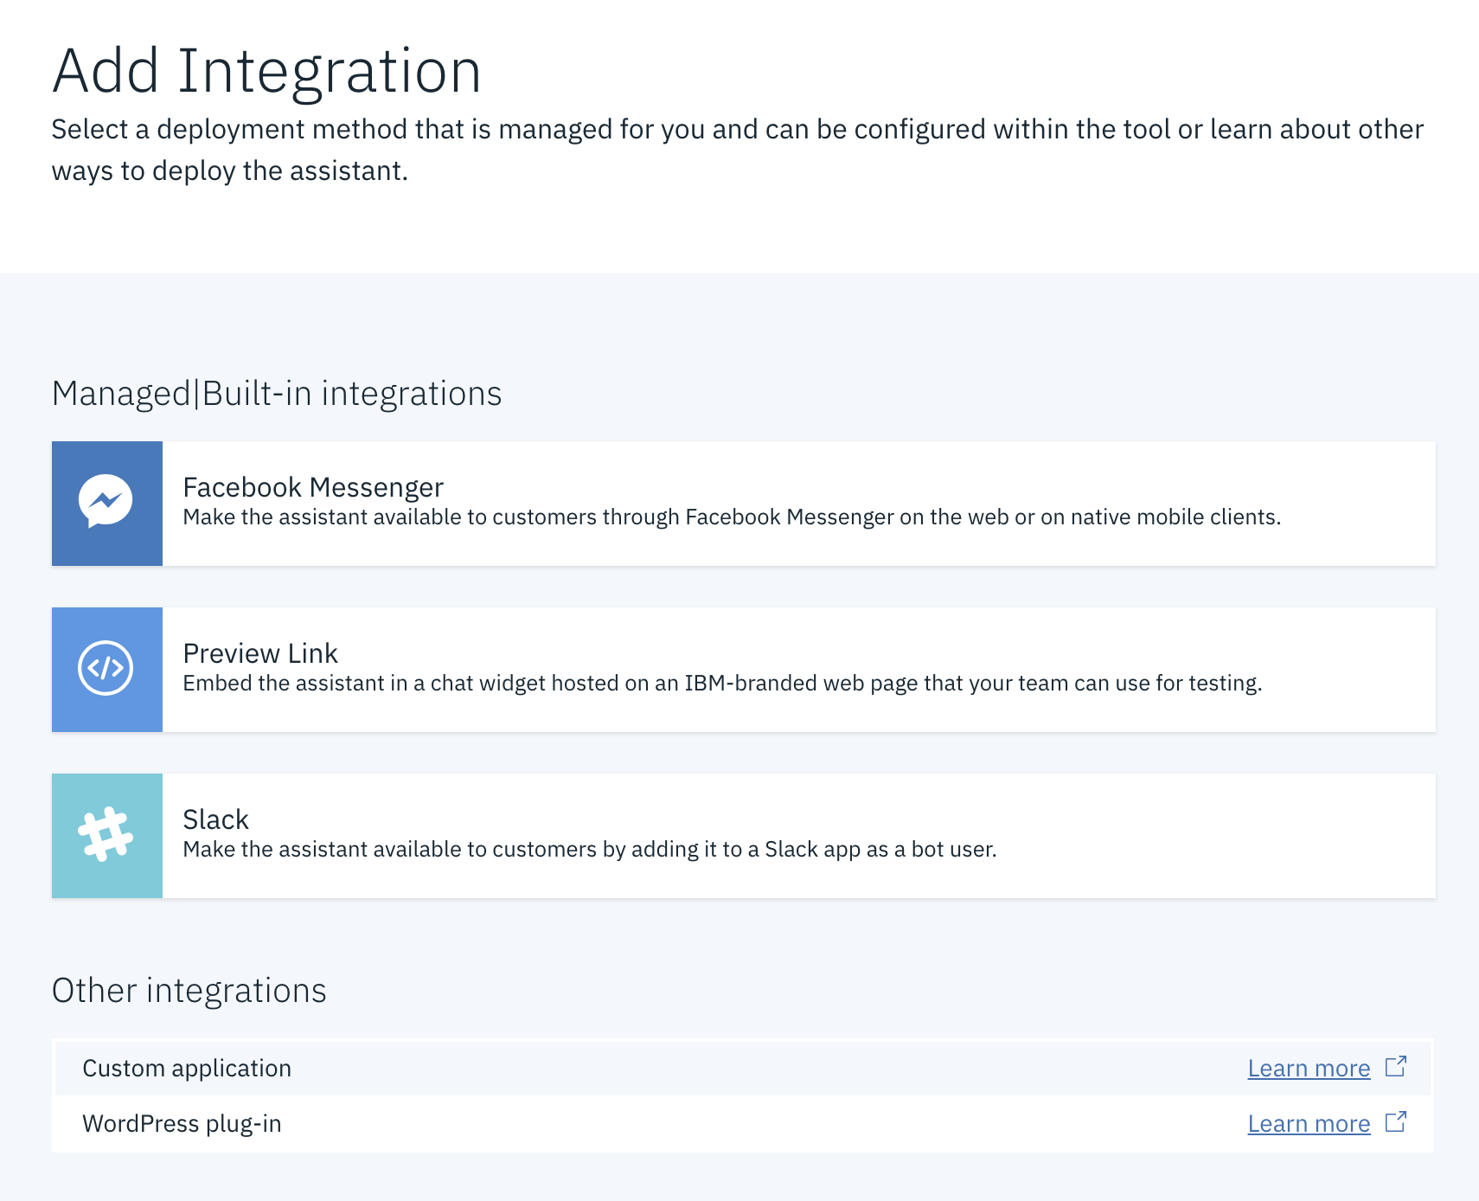
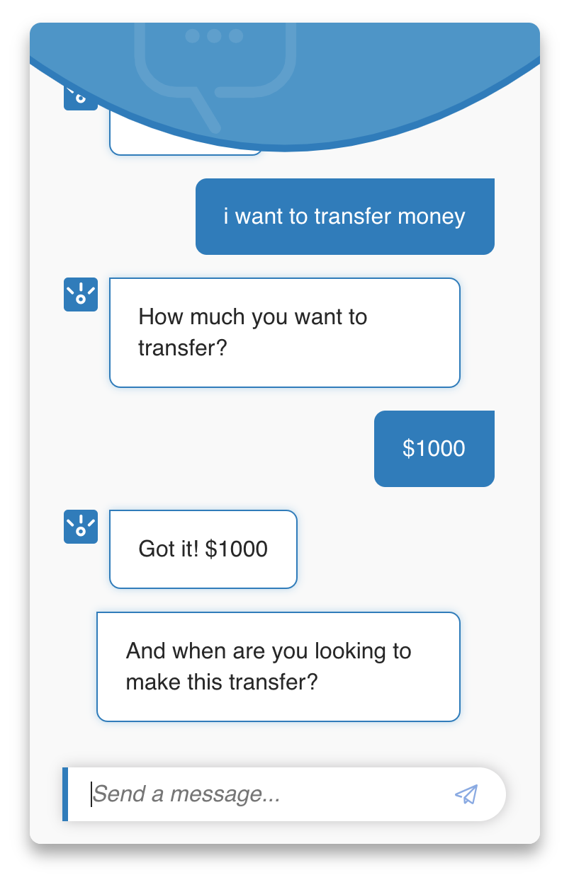
Watson Assistant
Solution
Enables callers to converse in natural language to address questions or complete tasks in real-time via phone
Recent Releases
Leverages Watson Assistant, Watson Speech, and IBM Voice Agent with Watson
Assistant / Skills
Assistant maintains session context and can connect to a number of managed integrations
Assistant references “skills” which contain reasoning logic and responses
Preview link integration allows you to quickly share your bot internally before launching
Benefits
Reduce cost of resolving customer query (deflection)
Improve customer satisfaction by answer & resolve calls more quickly
30
Notes:
Solution:
Enables callers to converse in natural language to address questions or complete tasks in real-time via phone
IBM Voice Agent, Watson Assistant, Watson Text to Speech, Watson Speech to Text
Problem Oriented Features:
Translate speech into natural language enabling a natural experience between a caller and automated agent
Seamlessly connects to existing call center infrastructure or telephone network directly
Benefits:
Reduce cost of resolving customer query (deflection)
Improve customer satisfaction by answer & resolve calls more quickly

Slide 31


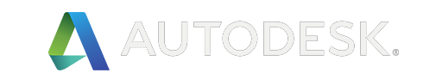

AutoDesk - Watson Assistant Use Case
99%
Connect
Improvements in customer response times for Autodesk by implementing Watson
With IBM and Salesforce, you’ll have the capability to seamlessly connect real-time insights found in unstructured data to discovery within customer data.
For more than 34 years, software giant Autodesk sold its popular 3D design, engineering and entertainment software under perpetual desktop licensing agreements. However, the way customers wanted to buy and access products changed. Recognizing that shifting to a subscription business model requires real-time customer service and support, Autodesk developed a virtual agent to interact with customers and improve their experiences.
5 – 10 min
10pt
60
Resolves cases in five to 10 minutes as opposed to a day and a half. And the only reason it takes five to 10 minutes is because that’s how long a customer needs to type in or find specific information, such as matching a serial number to an entitlement or contract
Different use cases recognized to quickly resolve easy requests so that agents can focus on helping customer with complex issues
10-point increase in customer satisfaction levels because customers don’t have to wait as long to have their questions answered
100,000
14M
5.4 min
Supports 100,000 conversations per month, easing the burden on call center staff
Analyzes a total of 14 million sentences for keywords, entities, phrases, clusters, and other speech and language patterns
Drastically reduces resolutions time from 1.5 days to just 5.4 minutes for most inquiries
Learn more
Read the full case study
Contact Us
https://www.ibm.com/watson/partnerships/
31
Notes:
(Source: CEB, Kick-Ass Customer Service, Matthew Dixon et al., January - February, 2017.)

Slide 32
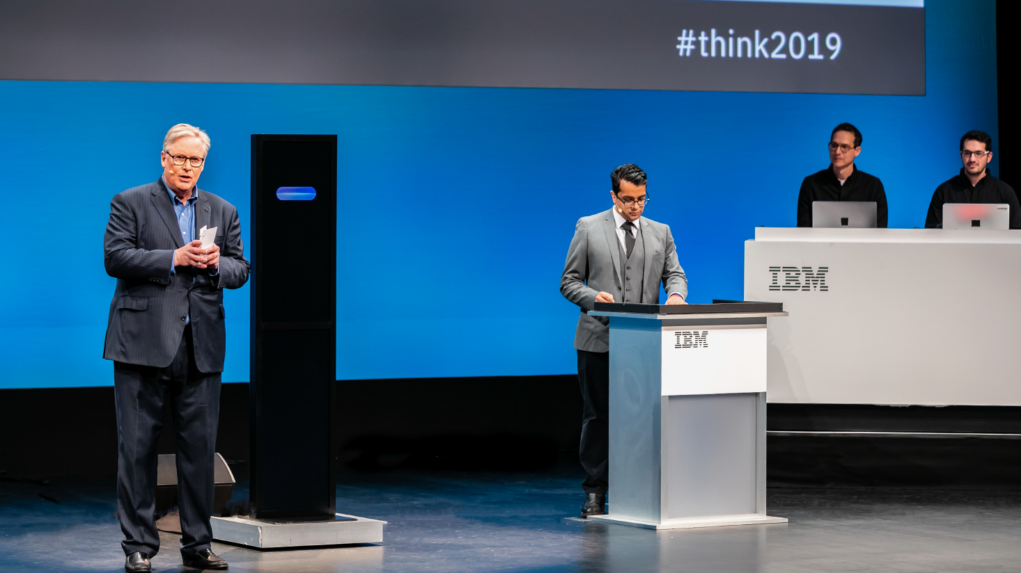
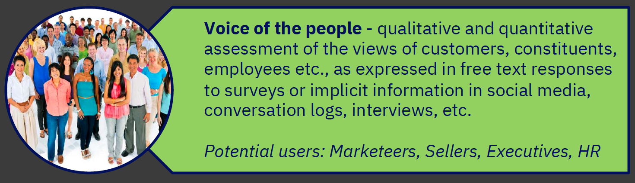
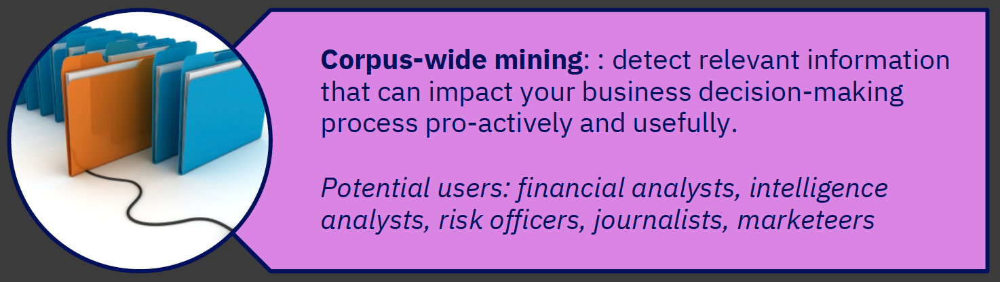
What is Project Debater?
A grand challenge IBM Research project which demonstrated:
A computer system that successfully participated in a verbal, competitive debate against a human opponent
Our advancement and integration of Natural Language Understanding, Natural Language Generation and the emerging field of computational argumentation
Try Project Debater at
https://ui.debater.res.ibm.com/domain/public
Project Debater Applications

Slide 33
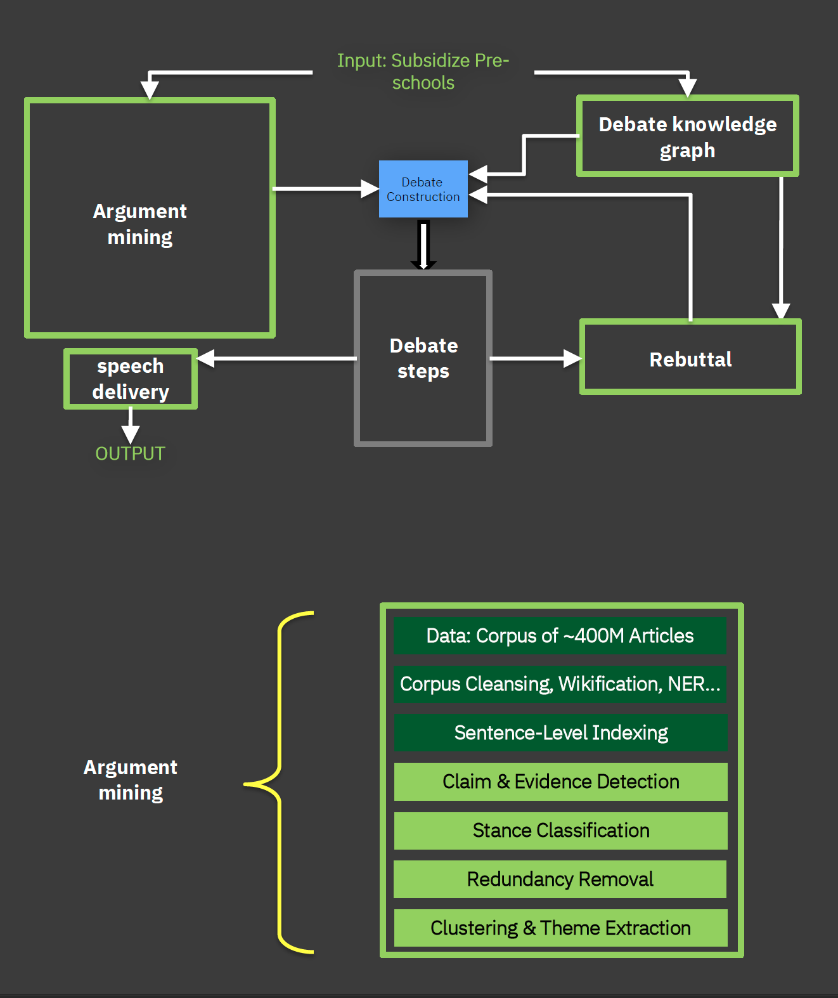
Project Debater Capabilities
Speech writing and delivery
Digest massive corpora
Create a well-structured narrative
Deliver with clarity and purpose
Listening with Comprehension
Identify key arguments in long continuous spoken language
Modeling Human Dilemmas
Model controversy
Propose principled arguments

Slide 34


Outline
IBM Cloud Overview
Watson Services Overview
Watson Studio Overview
Labs
47

Slide 35





IBM Watson Studio Platform
Drive governance policy effectiveness while tracking how data is used and its value to the company
Data Steward
Make the insights immediately actionable and add intelligence to apps in straightforward manner
App Developer
An integrated platform of tools, services, data, and metadata that help companies or agencies accelerate their shift to be data-driven organizations.
Data Engineer
Easily build data pipelines that power dashboards and data platforms while ensuring high quality
Business
Analyst
Build dashboards
and reports to visualize insights to the business
Data Scientist
Access powerful tools to tease out the insights using advanced analytics
Notes:
Watson Studio is an integrated platform of tools, services, data, and meta-data to help companies and agencies accelerate their shift to be data driven organizations. The platform enables data professionals such as data scientists, data engineers, business analysts, and application developers collaboratively work with data to build, train, deploy machine learning and deep learning models at scale to infuse AI into business to drive innovation. Watson Studio is THE IBM public cloud foundation designed to support the development and deployment of data and analytics assets for the enterprise.
Data and analytics vision of whole enterprises
Watson Studio accelerates the machine and deep learning workflows required to infuse AI into your business to drive innovation. It provides a suite of tools for data scientists, application developers and subject matter experts to collaboratively and easily work with data and use that data to build, train and deploy models at scale.
Watson data platform is THE IBM public cloud foundation designed to support the data and analytics vision of whole enterprises
Delivering a fully integrated platform that sustains both analytical investigations and putting insights into active use in production at any scale.
It delivers the user experiences that amplify the ability of every data professional to execute on that vision

Slide 36
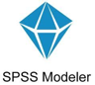





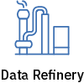







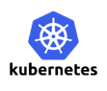





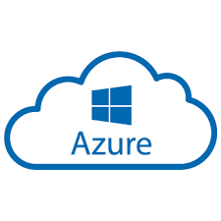
Watson Studio Tools
Build and train at scale
Using best of breed - Open source & IBM tools
Code (R, Python or Scala) and no-code/visual modeling tools
Authoring Tools
Decision Optimization
Visual
Recognition
Streams Designer
Auto AI
Machine Learning Runtimes
Deep Learning Runtimes
Container-based resource management
Elastic cpu/gpu power
Run on x86, Power, zLinux
Integrate with Hadoop/Spark Infrastructure
Scalable & modern infrastructure
Train and deploy where your data lives
IBM Cloud
Fully Managed
On-prem
IBM Cloud
Notes:
Create, collaborate, deploy, and monitor
Best of breed open source & IBM tools
Code (R, Python or Scala) and no-code/visual modeling tools
Open Source and IBM libraries/frameworks

Slide 37
Watson Studio supports the Data Science Lifecycle
Build, train, deploy, and monitor at scale ML/DL workflows to infuse AI into the enterprise to drive innovation.
Connect to Data
Find Governed Data
Save and Deploy
Build Model
Prepare Data
Monitor and Manage
Create Project
Research Topics
Notes:
Position these offerings in how they support the Data Science Project Lifecycle
Start with Creating a Project. The project is a core component of the IBM Data Science Platforms. It is a place where you can organize your resources to achieve a particular data analytics goal.
Research topics – may want to read an article about a technique. Go through a tutorial. Or start with an existing notebook.
Find data that is needed for your analysis.
Connect to data – or access the data
Data Understanding or Data Exploration and Preparation. -

Slide 38
Watson Studio Project Features
Create Project
Making Data Science a Team Sport
Organizes resources to achieve a particular data analysis goal
Support role-based collaboration (Admin, Editor, Viewer)
Assets from all IDEs can be included in one Watson Studio project: notebooks, data sources, flows, models, etc.
Export/Import Projects

Slide 39
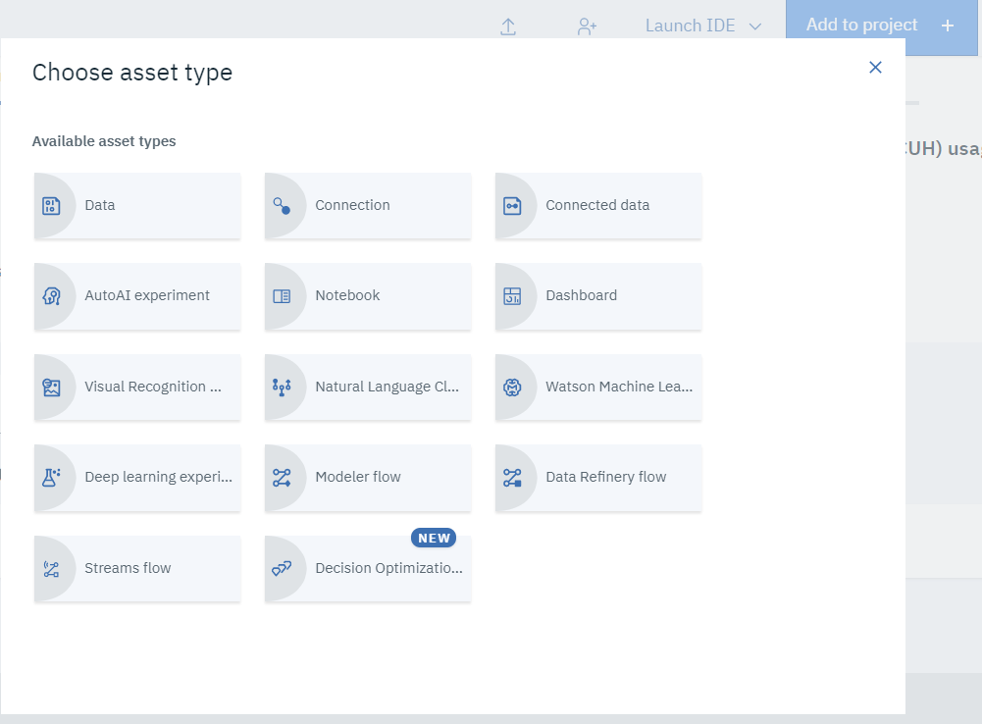
Add to Project

Slide 40
Watson Studio supports the Data Science Lifecycle
Build, train, deploy, and monitor at scale ML/DL workflows to infuse AI into the enterprise to drive innovation.
Connect to Data
Find Governed Data
Save and Deploy
Build Model
Prepare Data
Monitor and Manage
Create Project
Research Topics

Slide 41
Watson Studio Gallery
Research Topics
Built-in learning to get started
The Gallery includes notebooks, and data sets
Copy notebooks or Data Sets into projects
Continuously updated in IBM’s managed service

Slide 42
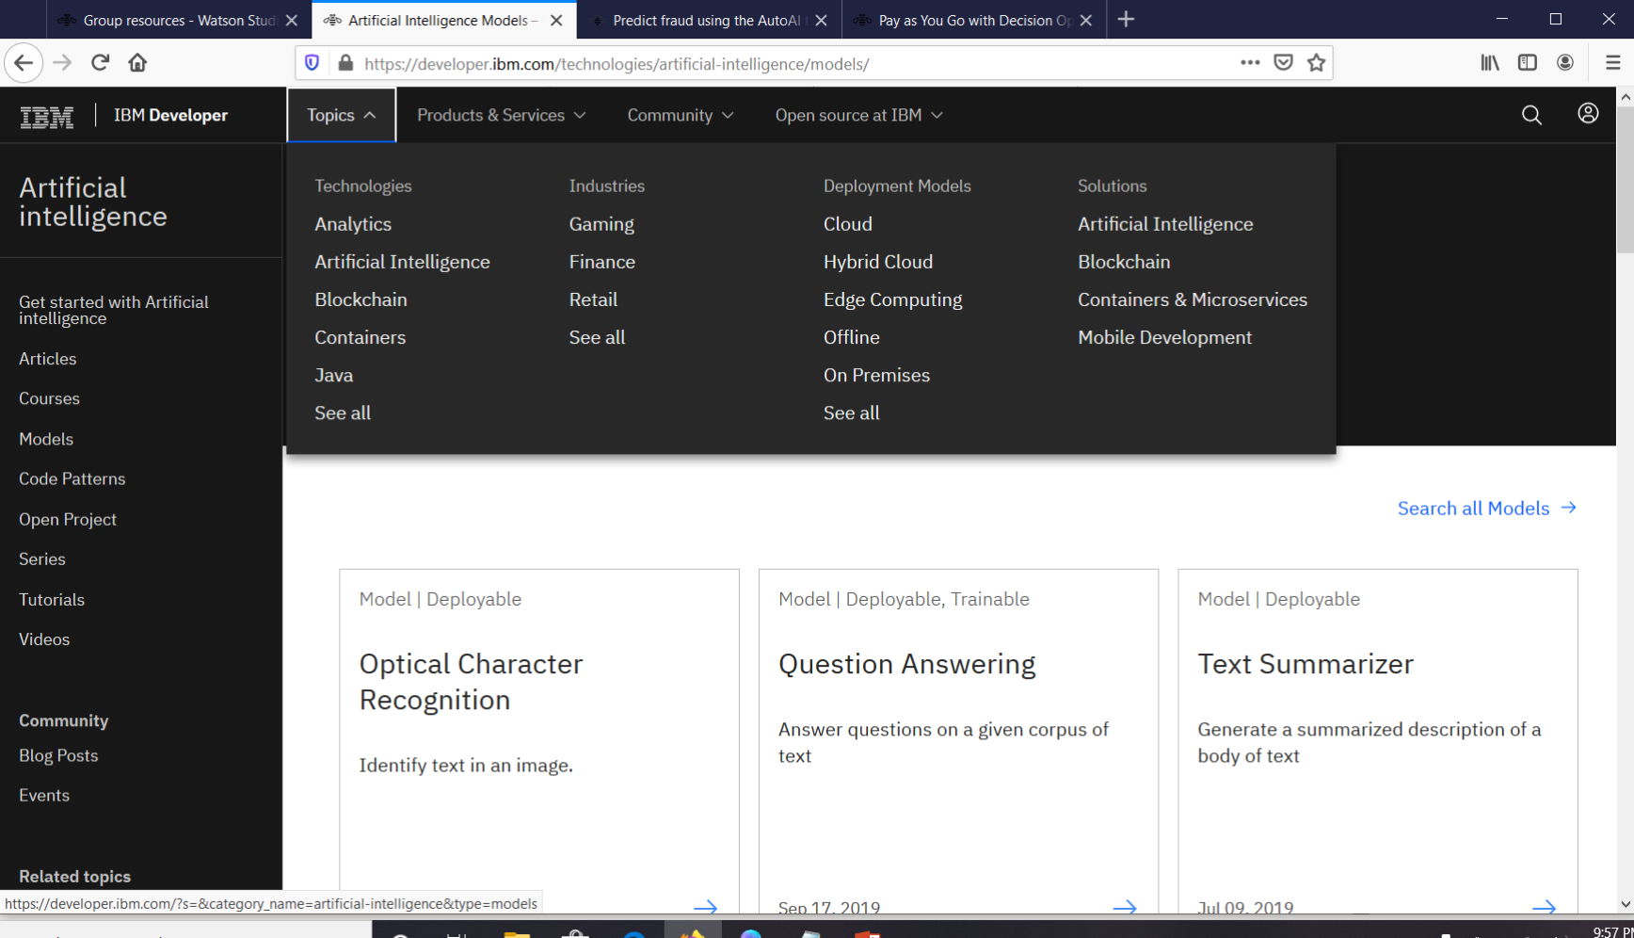
developer.ibm.com
Research Topics

Slide 43
Watson Studio supports the Data Science Lifecycle
Build, train, deploy, and monitor at scale ML/DL workflows to infuse AI into the enterprise to drive innovation.
Connect to Data
Prepare Data
Create Project
Research Topics
Find Governed Data
Build Model
Monitor and Manage
Save and Deploy

Slide 44
Watson Knowledge Catalog Features
Find Governed Data
Unlock tribal knowledge and unleash knowledge workers
Find data (structured, unstructured) and AI assets (e.g., ML/DL models, notebooks, Watson Data Kits) in the Knowledge Catalog with intelligent search and giving the right access to the right users.
Discover assets, profiling, classification
Policy, rule authoring
Policy, rule enforcement
Asset Usage Statistics

Slide 45
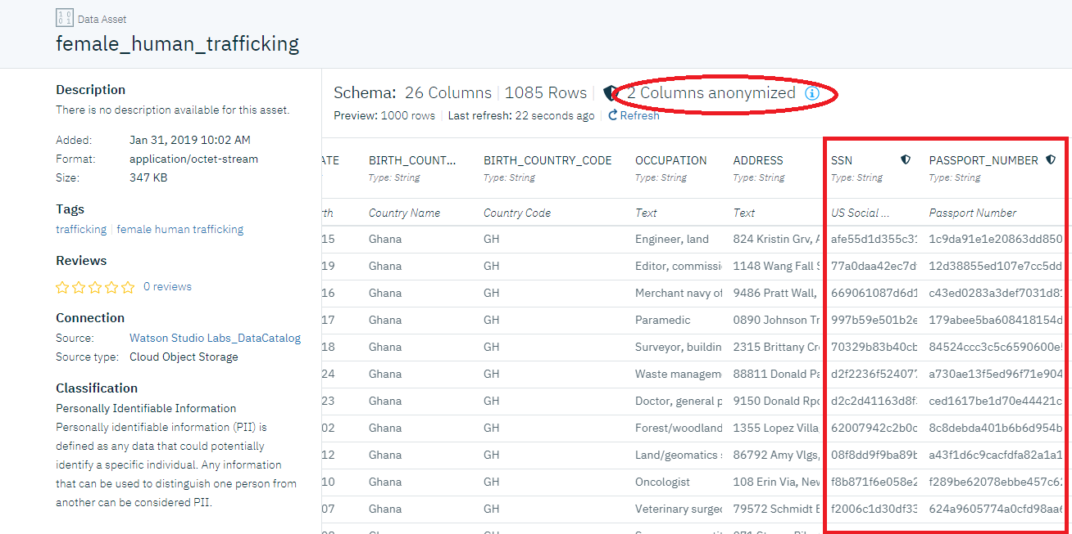
Watson Knowledge Catalog Features
Find Governed Data

Slide 46
Watson Studio supports the Data Science Lifecycle
Build, train, deploy, and monitor at scale ML/DL workflows to infuse AI into the enterprise to drive innovation.
Connect to Data
Prepare Data
Create Project
Resarch Topics
Find Governed Data
Build Model
Monitor and Manage
Save and Deploy

Slide 47
Watson Studio Connection Features
Connect to Data
Upload files
Connectors to Structured and Unstructured, On-prem and Cloud data sources.
Wizard based connection definition and code generation

Slide 48
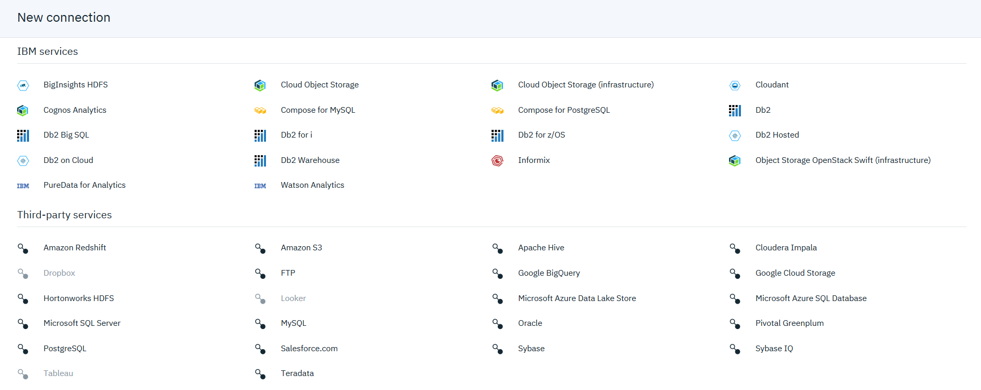
Connection Options
Connect to Data

Slide 49
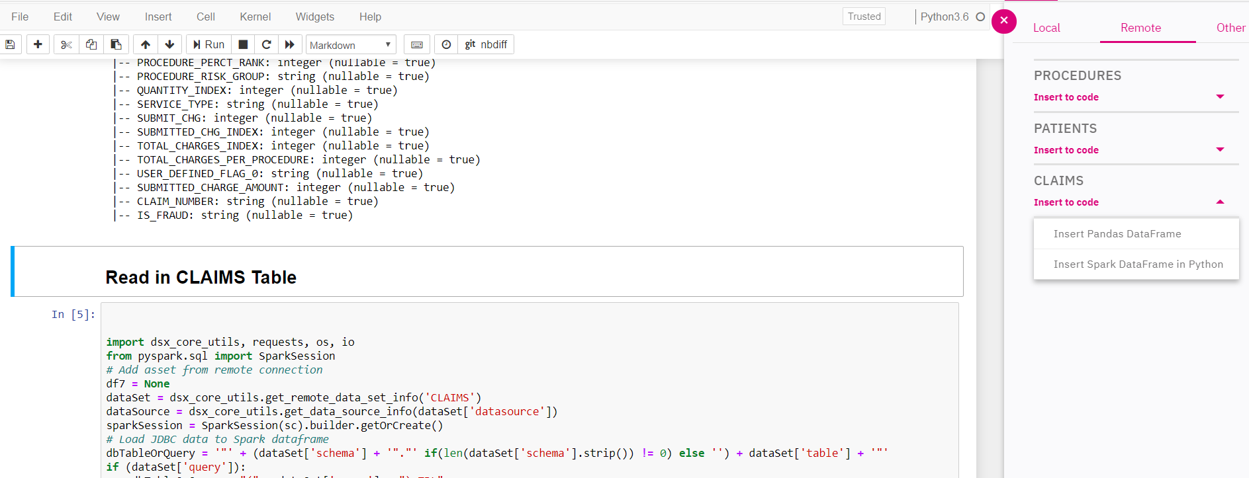
Notebook Screenshot
Connect to Data

Slide 50
Watson Studio supports the Data Science Lifecycle
Build, train, deploy, and monitor at scale ML/DL workflows to infuse AI into the enterprise to drive innovation.
Connect to Data
Prepare Data
Create Project
Resarch Topics
Find Governed Data
Build Model
Monitor and Manage
Save and Deploy

Slide 51
Watson Studio Data Refinery Features
Prepare Data
Making Data fit for use
Data Refinery tool to profile, visualize, and shape data.
Create data preparation pipelines via point and click capability on subset of data
Cleanse the data: fixing or removing data that is incorrect, incomplete, improperly formatted, or duplicated
Shape the data: customize data by filtering, sorting, combining, or removing columns, and performing operations
Run the pipeline on all the data
Manually (on demand)
Automated (scheduled)

Slide 52
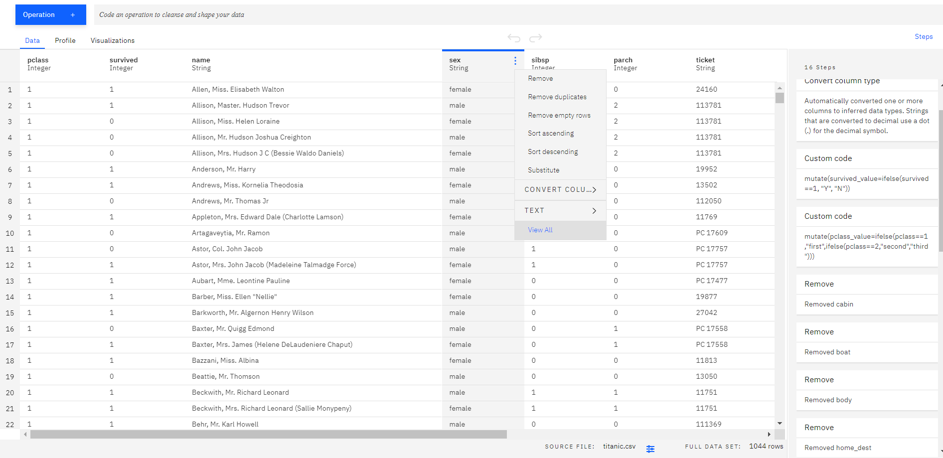
Data Refinery

Slide 53
Watson Studio supports the Data Science Lifecycle
Build, train, deploy, and monitor at scale ML/DL workflows to infuse AI into the enterprise to drive innovation.
Connect to Data
Prepare Data
Create Project
Resarch Topics
Find Governed Data
Build Model
Monitor and Manage
Save and Deploy

Slide 54
Watson Studio Model Building Features
Build Model
The best of open source and IBM Watson tools to create start-of-the-art data products
Open Source Tools
Jupyter Notebooks **
RStudio and Shiny
Libraries- scikit-learn, XGBoost, Spark, TensorFlow, Caffe, Keras, PyTorch
IBM Tools
AutoAI
SPSS Modeler
Experiment Builder
Decision Optimization **
Natural Language Classifier Model
Visual Recognition Model
** in hands-on labs

Slide 55
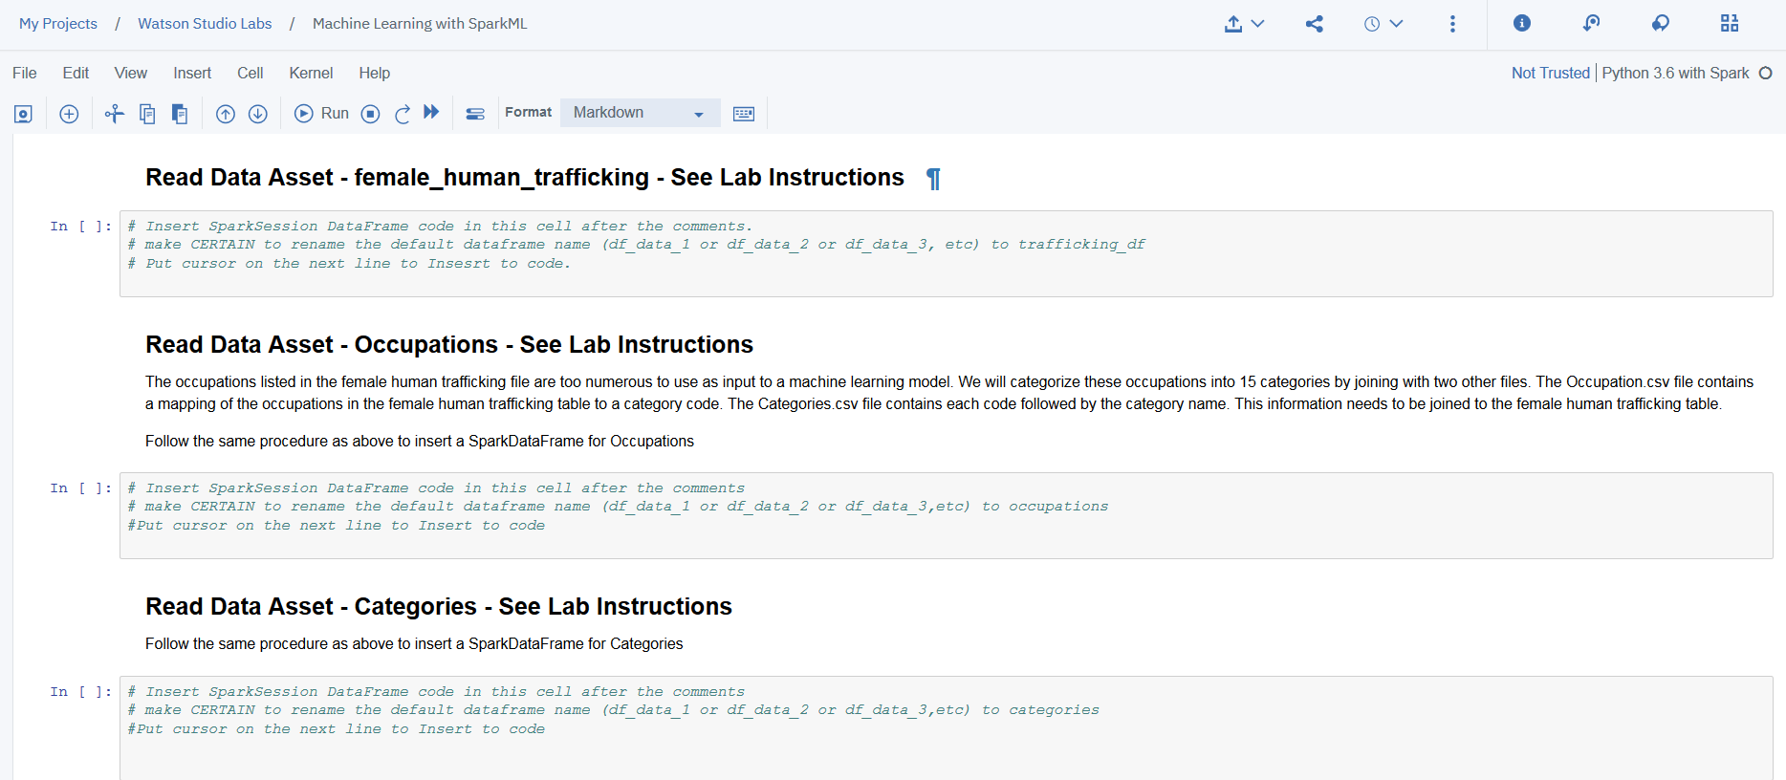
Jupyter Notebook
Build Model

Slide 56
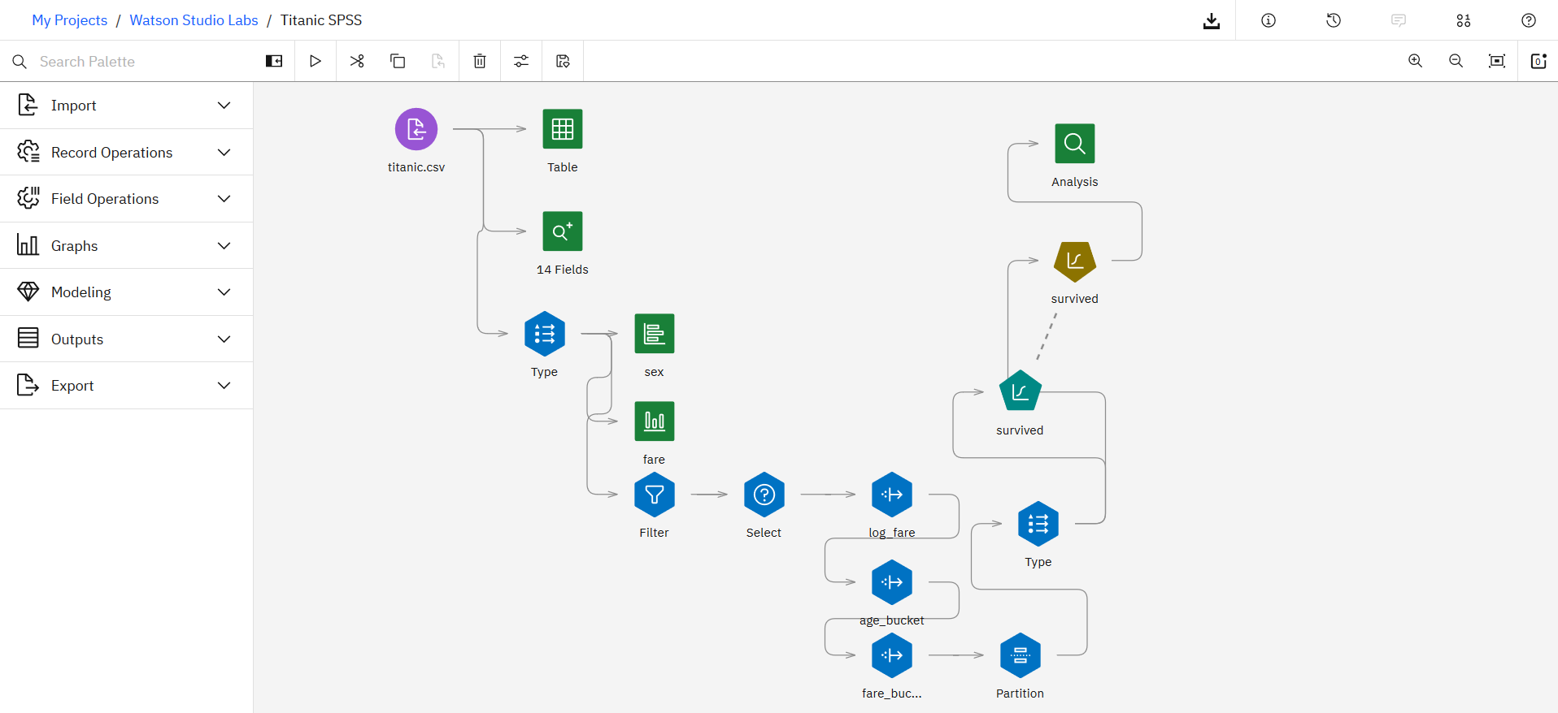
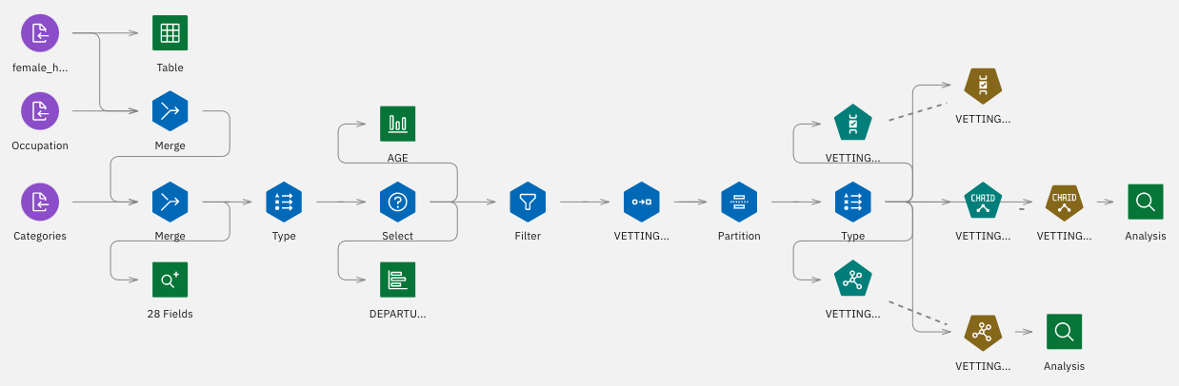
SPSS Modeler
Build Model

Slide 57
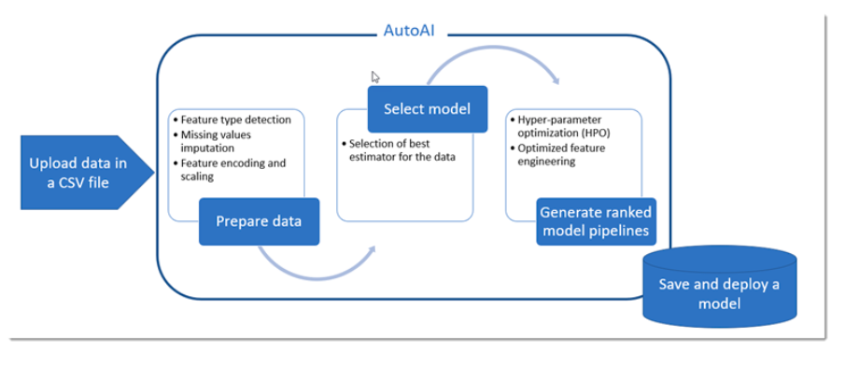
AutoAI
Build Model

Slide 58
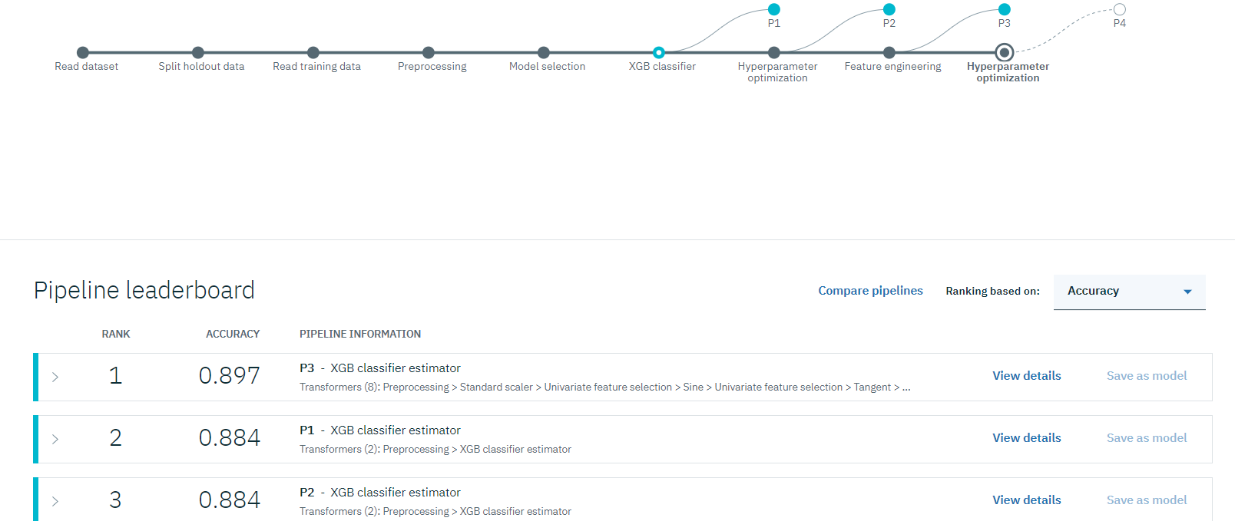
AutoAI
Build Model

Slide 59
Experiment Builder
Build Model
10’s-100’s experiments
neural
network
batch_size
dropout
learning_rate
…
hyperparameters
designs
varies
trains
100’s-1000’s
models
evaluates
Experiment Builder
supports the end-to-end workflow
Notes:
Traditional machine learning focuses on selecting the right algorithm then tweaking the few available parameters. Deep learning significantly increases the complexity of model building by requiring data scientists to first design then tweak the dozens of interrelated parameters in neural networks structures. But AI is where all the complexity converges. We speak about AI as though it’s a single model or neural network but it’s not. AI is about multiple algorithms, neural networks, data and support systems working together as a system. So the challenge of AI is not about training a single model but about architecting numerous data-driven services which that the underlying complexity and hidden and emerges as a seemingly cognitive system.

Slide 60
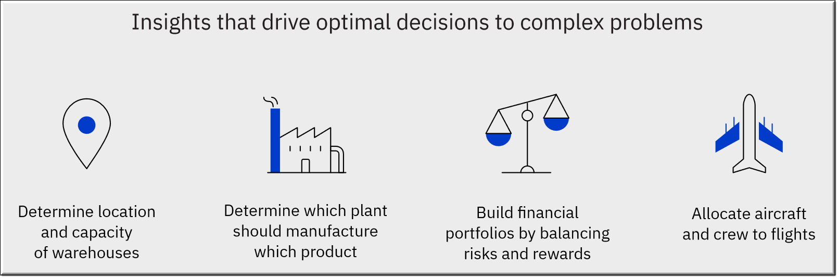
Decision Optimization
Build Model
Decision Optimization (DO) enables data science teams to capitalize on the power of prescriptive analytics and build solutions using a combination of techniques like optimization and machine learning.
Integrated with Watson Studio, Decision Optimization can combine optimization techniques with coding and non-coding tools, model management and deployment – as well as other data science capabilities.
Decision Optimization evaluates millions of possibilities – balancing trade-offs and business constraints to find the best possible solution.

Slide 61




Watson Studio Dynamic Dashboards
Making insights available to all
Build Model
3
Notes:
Visualize – represent analytical results as compelling interactive graphics
Immediately view effective visualizations fitting the data selected.
Choose your favorite graph or chart type from palette of options
Apply Filters to individual or multiple visualizations.
Customize appearance with individual settings or dashboard themes.
Share - Deliver dashboards across the enterprise, providing insights where business decisions are made.
Collaborate on dashboards with other project users.
Share interactive dashboards through a public URL for use by others outside the platform.
Discover - Utilize enterprise data assets with confidence through projects and the Watson Knowledge Catalog.
Access data assets associated with your project
Data sources may be local uploaded files or connections to relational sources.
Search for data through the data catalog, then explore using dashboards
1) Create a Dashboard from a selection of easy to use formatted templates
2) Create a visualization simply by selecting data items from the tree and dragging onto the canvas. System chooses effective visualization based on number and type of data selected.
3) How dashboards are integrated into projects & Share Dashboard with others via URL
4) Create compelling and comprehensive dashboards without coding or knowledge of SQL

Slide 62
Watson Studio supports the Data Science Lifecycle
Build, train, deploy, and monitor at scale ML/DL workflows to infuse AI into the enterprise to drive innovation.
Connect to Data
Prepare Data
Create Project
Resarch Topics
Find Governed Data
Build Model
Monitor and Manage
Save and Deploy

Slide 63

Watson Studio Save and Deploy Models
Save and Deploy
Save and Deploy Models with Watson Machine Learning

Slide 64
Watson Studio Save and Deploy Trained Models
Save and Deploy Models with Watson Machine Learning
Watson Machine Learning
train
infrastructure
deploy
infrastructure
invoke
REST
API
prediction
App
save
REST
API
prediction
App
artifact
repository
deploy
hosted
models
REST
API
prediction
App
REST
API
prediction
App

Slide 65
Watson Studio Save and Deploy Features
Save and Deploy
Save and Deploy Models with Watson Machine Learning
Watson Machine Learning API to save/load models to/from repository
Watson Machine Learning API to deploy saved models easily and have them scale automatically.
Watson Machine Learning API to invoke deployed models
Notes:
And with our Deployment Manager, without any coding, you can easily deploy a trained model on prem, in the cloud, or remotely to a Spark cluster in HortonWorks Data Platform.
Also, our model management dashboard shows the predictive accuracy of your models. Data scientists and IT can review, and even schedule evaluation of deployed models, so you spend less of your time managing what’s in production, and more time on driving business results.

Slide 66
Watson Studio supports the Data Science Lifecycle
Build, train, deploy, and monitor at scale ML/DL workflows to infuse AI into the enterprise to drive innovation.
Connect to Data
Prepare Data
Create Project
Resarch Topics
Find Governed Data
Build Model
Monitor and Manage
Save and Deploy

Slide 67




Our vision for Trusted AI
Monitor and Manage
Pillars of trust, woven into the lifecycle of an AI application
#21, #32, #93
#21, #32, #93
Is it
accurate?
Is it fair?
Is it easy to understand?
Did anyone tamper with it?
Notes:
… and as they did we realized that they can have profound implications on our society. Once upon a time we used to build algorithms for accuracy, but that is changing. There is a realization that if they are going to be governing important aspects of our lives, they need to be more than just accurate – we need to trust them. So what does it take to trust and algorithmic decision?

Slide 68
Watson OpenScale
Monitor and Manage
Trust and Transparency
Intelligently delivers bias mitigation help
Provides traceability & auditability of AI predictions made in production applications
Tracks AI accuracy in applications
Explains an outcome in business terms
Drift Detection
Automation
Automatically detects and mitigates bias in model output, without affecting currently deployed model or outcomes
Open By Design
Monitor models deployed on third party model server engines
Deploy behind enterprise firewall or on IaaS provider

Slide 69
Watson Studio Takeaways
Integrated Collaboration Environment
Choice of Tools for the full AI lifecycle
Support for all levels of expertise
Data Scientists, Subject Matter experts, Business Analysts & Developers all in one environment to accelerate innovation, collaboration and productivity
Built-in learning to get started or go the distance with advanced tutorials
Best in-breed open source and IBM tools that support the end-to-end AI lifecycle
Choice of code or no-code tools to build and train your own ML/DL models or easily train and customize pre-trained Watson APIs
Use Watson smarts and recommendations for the best algorithms to use given your data, OR
Use the rich capabilities and controls to fine tune your models
Multiple Deployment Options
Model lifecycle & management
Integrated with Knowledge Catalog
Watson Studio on IBM Cloud – Managed offering
Watson Studio Local – Private Cloud, Public Cloud-(IBM, Azure, AWS)
Watson Studio Desktop
Deploy models into production then monitor them to evaluate performance.
Capture new data for continuous learning and retrain models so they continually adapt to changing conditions.
Intelligent discovery of data and AI assets that enables reuse & improves productivity
Seamlessly integrated for productive use with Machine Learning and Data science
Powerful governance tools to control and protect access to data

Slide 70
Outline
IBM Cloud Overview
Watson Services Overview
Watson Studio Overview
Labs
47

Slide 71
Lab-1: Watson Knowledge Studio
Introduction:
In this lab, you will use Watson Knowledge Studio to develop socioeconomic annotators for COVID-19.
Objectives:
Upon completing the lab, you will know how to:
Create and edit a type system
Create a dictionary for each entity type
Upload a training corpus
Perform manual annotation
Train and create a machine learning (ML) annotator
Save and deploy the ML annotator to Watson Discovery

Slide 72
Applying AI, NLP, and Optimization to COVID-19
Lab 1 in progress.
We will return to the main room at 11:30 am.

Slide 73
Lab-2: Watson Discovery
Introduction:
In this lab, you will use Watson Discovery to develop a knowledge management system (KMS), train the KMS to generate knowledge and analyze information to create a COVID-19 vulnerability index.
Objectives:
Upon completing the lab, you will know how to:
Create a collection and upload data
Add the entity model from Knowledge Studio
Perform custom entity extraction
Retrieve the analyzed files using the Discovery API
Calculate the COVID-19 vulnerability index
Perform Smart Document Understanding on a COVID-19 publication
Create and run Natural Language Queries
Use relevancy training to improve the relevance of results

Slide 74
Applying AI, NLP, and Optimization to COVID-19
Lab 2 in progress. We will return to the main room at 12 pm break for lunch.
Continue working lab 2 at 12:30 pm
We will return to the main room at 1 pm

Slide 75


Watson Assistant
is the AI-powered foundation of smart customer experiences.
Centralize your customer communication and problem resolution
Get started fast with your existing logs and web content
Go live without needing a developer
Dynamically manage vague questions
Assistant
Skills
Dialog
Search
Agent
Customer
Channel
Resolution
Provides explicit answers
Unifies existing content
Provide support when needed
IBM Watson / © 2020 IBM Corporation

Slide 76

Watson Assistant
Low-code platform
Intuitive building interface that helps you– from coders to the C-suite – to successfully build and deploy an assistant quickly.
Deploys anywhere
One of the only vendors in the market that allows you to deploy and run a virtual assistant on premises or on any public cloud.
Powered by best in class NLU
Best in class AI powers the underlying language models, so you can build the smartest assistant your business.
Seamlessly hands off to your agents
Connect to your existing service desk to transfer conversations to human agents
Market Differentiation
Connects to any channel
You have channels, applications, and content in place. Make the most of them. We make it possible to connect to (almost) anything.
Scales effortlessly
An enterprise can go from a single user to supporting millions of conversations across its organization with a single product.
IBM Watson / © 2020 IBM Corporation

Slide 77
Watson Assistant
Driven by intents, not rules
Watson Assistant understands the user’s intent
Handcrafted rules unable to scale and do not benefit from data
State of the art NLU to derive intent
Learns over time based on usage
IBM Watson / © 2020 IBM Corporation

Slide 78

Intent Password Reset
“
”
I forgot my password...
“
”
How do I get a new password?
“
”
Can’t login into your site…
“
”
My login isn’t working, please help…
“
”
Can you reset my password?
IBM Watson / © 2020 IBM Corporation

Slide 79
Extract other key information from a question
“
I’m frustrated, I haven’t been able to login into your online billing system
Intent Password Reset
”
IBM Watson / © 2020 IBM Corporation

Slide 80
Extract other key information from a question
“
I’m frustrated, I haven’t been able to login into your online billing system
Intent Password Reset
Entities Online Billing System
”
IBM Watson / © 2020 IBM Corporation

Slide 81
Extract other key information from a question
“
I’m frustrated, I haven’t been able to login into your online billing system
Intent Password Reset
Entities Online Billing System
Emotional Tone Anger
Leverages Watson Tone Analyzer
”
IBM Watson / © 2020 IBM Corporation

Slide 82
Extract other key information from a question
“
I’m frustrated, I haven’t been able to login into your online billing system
Intent Password Reset
Entities Online Billing System
Emotional Tone Anger
Leverages Watson Tone Analyzer
”
Context Bill Smith, 47 / Gold Member
Context Mobile
IBM Watson / © 2020 IBM Corporation

Slide 83
Webhooks
Webhooks let you pull in user information to personalize answers, post transactions to internal systems, check other systems for answers to questions, you name it—all in-line within your dialog.

Slide 84
Lab-3: Watson Assistant – COVID-19 Chatbot
Introduction:
This lab will build a chatbot to respond to questions about COVID-19. Watson Assistant and Watson Discovery services from IBM will be used to build the chatbot.
Objectives:
The goal of this lab is to familiarize the user with the Watson Assistant service. Watson Assistant is IBM’s AI offering that lets you build, train, and deploy conversation interactions into any application, device, or channel. Watson Assistant can be deployed on any cloud or on-premises environment.
After completing this lab, you will be familiar with these features of Watson Studio.
Provision an instance of Watson Assistant Plus Trial
Add a dialog skill to your Watson Assistant instance
Connect your Watson Assistant with Watson Discovery
Create Cloud Functions
Integrate data sources via a Watson Assistant webhook

Slide 85
Applying AI, NLP, and Optimization to COVID-19
Lab 3 in progress.
We will return to the main room at 2:30 pm.

Slide 86


IBM Watson Studio
Enterprise Data Science platform that helps your team work together to build models to make better data driven decisions for your business
Analyze any data, no matter where it lives
Connect to and analyze your data without moving a single byte through dozens of connectors and multiple deployment options
Empower your entire organization with notebooks, visual productivity, and automation tools
Leverage your entire organization with a variety of tools in a single integrated platform
One platform to rule them all from discovery to production
Analyze data, build predictive models, and seamlessly integrate Watson Machine Learning to deploy at scale
Notes:
2. Empower your entire organization with open source integrated development environments (RStudio, Jupyter Notebooks), visual productivity, and automation tools
Without having to move to a new database we have DS solution that will work for you – coud, local dektop, connectors
“we are not making money on where your data is hosted” – you don’t have to move your data
These are things I’m running into
Building upon previous slides what are we introducing today? Meets your wants while solving your problems
Low to high DS skills spectrum
How does WS fit into the trends – looking at BMC for cloud + WS → whatis our value to customer; how are we differentiating from SPSS Modeler?
30 min filling in BMC
30 mins which messages do we want to articulate given strwngths as offering and where we’re going
Goal: crisp & differrentiating
Okay so now diving a level deeper – and again each of these will go back to the 3 values we have on the board
WS = DS platform where your whole team can work together – meaning DS, LOB expert, business analyst, or anyone working on the DS platform – it’s very easy to bring all these people with different levels of expertise on the 1 platform of WS
The reason all these varying levels of expertise can work together is because of these tools you see on the right
DS are rare resources – they each have their own preferences of tools or languages that they want to work with so we have open source tools like R studio and Jupyter Notebooks where DS can come in and write their own code by choosing their own language (R, Scala, whatever they want), and go ahead and get started
At the same time, if someone is not really into coding but has the knowledge, they can use visual tools - like SPSS Modeler, Data Refinery, & Model Builder – where they have a drag and drop UI they can use to build a model normally and get predictions
Both sides are available in the same platform of Watson Studio.
You can give different access to different people.
The whole point is that WS really reduces the barrier between your resources and the DS journey – anyone can get started regardless of their expertise
→ which brings us back to the strategy of increasing your team productivity
You can see on the right, we provide different technologies and frameworks to support building models - you can use Spark or if you're working with Deep Learning we support all the other favorites so you can choose any of these and work on Studio
Let's say you're into deep learning, but you are not a coder, we have a drag & drop interface where you can build a deep learning model, expose that node, and use it in some other applications
We provide all these cutting edge infrastructure technologies so you can take advantage of any of them while you are working in WS
Again: easy, fast, and increases your team productivity
Again getting started very quickly to increase productivity

Slide 87

IBM Watson Machine Learning
Embed Machine Learning and Deep Learning in your Business
Deploy and Manage Models
Move models to production, in an easy, secure, and compliant way
Intelligent Model Operations
Embed intelligent training services, with feedback loops that constantly learn from new data, regardless where it resides
Accelerate Compute Intensive Workloads
Distribute your deep learning training and Hadoop/Spark workloads with multi-tenant job scheduling
Notes:
You built models, you can use them by putting things on a presentation
You want to deploy them; challenges of ENGINEERING mis-skill, multi-cloud
Compute intensive. DL distribution, performance in-app or interactive work
----
Deploy & Manage Models:
WML is all about deploying it into production so you can start generating predictions and in turn those business insights
Typically operationalizing models – bringing them from development to deployment is a big challenge – and WML makes it very easy
Also, it’s on the same platform – so you don’t have to move your work from different code bases to get started with ML – you just have to add it as a service within WS and then you can manage your model into production
Intelligent Model Operations:
Once you deploy your model you can do all the model management things – it’s very flexible how you do that – you have user interface, APIs – based on your deployment you can choose any of those and work with your model
Once your model is in production you can monitor it to see how its’ performing over time – if its not performing well you can retrain the model - you can automate that with the help of WML
Accelerate Compute Intensive Workloads
You can take advantage of the ML Accelerator, for optimizing GPU to manage your intensive workload and get all those processes working in production
Now at this phase we have all the governance in place, the model is created and deployed into production, and is making predictions that we want to use to impact business decisions.
But now again, we go back to that question of “Do you trust your model? Is it fair? Are there any biases?” Which brings us back to WOS

Slide 88
Machine learning and optimization: better together
Predictive analytics
Basic (supervised): You know the answer, and you train the machine how to find it.
Advanced: Unsupervised, reinforcement, deep learning
Prescriptive analytics
You don’t know the answer, and you provide the machine the logic on what is a good and a bad solution.
Advanced: Robust, stochastic, etc.
Unknowns (decision variables)
Sample data
Train model
Prediction
(optional)
Solve model
Decisions, plans, schedules
Observations
Solve trained model
Prediction, pattern, classification
Business goals
Business constraints
Notes:
Learning 101
Basic (supervised): you know the answer and you teach the machine how to find it
More advanced
Unsupervised learning: machine discovers patterns
Reinforcement learning: awards indicate success – think self-driving cars
Deep learning: pattern/image/object/speech recognition, text processing, time series analysis
Optimization 101
You don’t know the answer, and you teach the machine the logic to find it
Capture business goals, decision variables, and constraints
More advanced – robust/stochastic
Parallels between machine learning & decision optimization
Complexity
Both involve complex mathematics and algorithms
Both require experts to effectively build & deploy solutions
Both involve exponential network growth (e.g. MIP trees, deep nets), and often weights & probabilities (e.g. stochastic)
Proven – both have been around for decades
Data
Results depend on the quality of data
Require analysis to verify the accuracy of results (training vs post-optimization analysis)

Slide 89


Capitalize on the power of prescriptive analytics with Decision Optimization
Create innovative solutions
Combine optimization technology with data science techniques such as machine learning
Improve productivity
Validate optimization models more quickly and easily using visual dashboards
Experience fast time to value
Solve optimization models quickly across domains using powerful solvers
Operationalize your projects
Deploy optimization models in production to drive business impact around real use cases
IBM Watson / © 2019 IBM Corporation
89
Notes:
Key idea: IBM® Decision Optimization for Watson Studio accelerates innovation and productivity.
Talking points:
Drive operational efficiency
Decision optimization combines mathematical and artificial intelligence techniques to help make important business decisions that involve multiple decision variables, trade-off possibilities and complex constraints.
Integration with IBM® Watson Studio lets you combine optimization and machine-learning techniques with model management and deployment capabilities.
Optimize complex business decisions to generate significant return on investment across a wide range of industries.
Simplify the process of creating optimization models
The optimization wizard guides you during creation of optimization models around scheduling and resource assignment.
The modeling assistant uses natural language interactions to define goals and constraints for the model—no coding required.
Starts with data input and analyzes the appropriate constraints for the problem that you are trying to address

Slide 90
Lab-4: Watson Studio – Forecast COVID-19 Outbreaks
Introduction:
This lab will apply predictive analytics to analyze different factors among people to predict future COVID-19 infection rates in an area. Based on areas predicted to have high COVID-19 infections – this lab will apply optimization techniques to optimize the planning of transferring COVID-19 patients from hospitals located in epidemic areas to hospitals with less COVID-19 patients. Our hope is to educate people how to apply IBM's predictive and optimization technologies to help them improve planning and responding to COVID-19 cases.
Objectives:
The goal of this lab is to educate user on how to apply IBM predictive analytics and optimization tools to different applications of COVID-19 like (1) predicting future infections and (2) optimizing response for better decision making. We intend students learn these skills.
Load data form different places to be used for analysis
Represent the current situation on a map using folium
Use a LinearRegression to predict new cases to come for each department
Use Decision Optimization to model and optimize plan transfers
Use folium to display the optimized future patient transfers plan

Slide 91


Lab-4 Overview
The Lab contains these parts:
Upload data into your project
Use WS data import function (departements.csv)
Create/import a notebook (FranceCovid19.ipynb)
Load the data form different places (departements, current situation, etc)
We use data from the French government data.gouv.fr site in addition to some imported data on the different French administrative “departments” (GPS coordinates)
Represent the current COVID-19 infection situation on a map
Circles show the number of reanimation cases in each department
Predict new cases to come for each department
Illustrative purposes - train a simplistic predictive LinearRegression model (epidemy is not linear)
Develop a plan transfers optimization model
Our hypothesis for the optimization model is that two different types of transfers can be done:
long distance transfers (planes, trains) with the number of transfers limited over the whole country, several people can be transferred at a time.
Short distance transfers (ambulances) with the number of transfers limited per area, and with just one person at a time
Display all the transfers from the optimized patient transfer solution

Slide 92
Applying AI, NLP, and Optimization to COVID-19
Lab 4 in progress.
We will return to the main room at 3:30 pm.

Slide 93

Cognos Analytics COVID-19 Dashboard --

Slide 94

Workflow
Prepare – Select and combine data sources using a drag and drop interface.
Visualize – Create a series of interactive dashboards and reports.
Share – Export reports or embed Cognos dashboards in 3rd party applications and websites.

Slide 95
Weather API
Tracking Global Progression of COVID-19
Data collected from API:
Total cases up to May 20th
New cases added each day
Total Deaths up to May 20th
New deaths added per day
Sourced from WHO, U.S. state and country government sources
Bundled into 3 csv files
Notes:
https://accelerator.weather.com/bi/?perspective=dashboard&pathRef=.public_folders%2FCOVID19%2FDashboards%2FDS%2FCOVID-19%2B%2528Coronavirus%2529%2BGlobal%2BStatistics&action=view&mode=dashboard&ui_appbar=false&ui_navbar=false

Slide 96
Lab-5
Introduction:
In this lab, you will use Cognos Analytics to develop a series of dashboards to display COVID-19 data pulled from the IBM & Weather Channel COVID-19 data fabric. IBM Cognos Analytics is an integrated toolset for reporting, analytics, and visualization.
Objectives:
Upon completing the lab, you will know how to:
Create a Cognos Dashboard using templates.
Upload data into Cognos Analytics
Build and customize visualizations
Create links to external websites tabs
Work with calculations and filters for individual tiles

Slide 97
Cognos Analytics
Workflow
Prepare
Select and combine data sources using a drag and drop interface.
Visualize
Create a series of interactive dashboards and reports.
Share
Export reports or embed Cognos dashboards in 3rd party applications and websites.
Notes:
https://accelerator.weather.com/bi/?perspective=dashboard&pathRef=.public_folders%2FCOVID19%2FDashboards%2FDS%2FCOVID-19%2B%2528Coronavirus%2529%2BGlobal%2BStatistics&action=view&mode=dashboard&ui_appbar=false&ui_navbar=false

Slide 98
Weather API
Tracking Global Progression of COVID-19
Data collected from API:
Total cases up to May 20th
New cases added each day
Total Deaths up to May 20th
New deaths added per day
Sourced from WHO, U.S. state and country government sources
Bundled into 3 csv files

Slide 99
Lab-5: Cognos - COVID-19 Dashboard
Introduction:
This lab will build a series of Cognos Dashboards to display COVID-19 data.
Objectives:
The goal of the lab is to familiarize the user with the use of the Cognos Analytics web-based business intelligence suite. IBM Cognos Analytics contains integrated toolsets for reporting, analytics, and visualization. This lab will focus on the visualization component. We will be creating three tabs similar to those on the IBM & Weather Channel COVID-19 Dashboard. IBM created a data fabric pulled from state and local governments as well as the World Health Organization. Where the public dashboard updates dynamically based on daily data pulls, we will use extracted data tables for the lab to build visualizations for a specific set of dates.
After completing this lab you will be familiar with these features of Cognos Analytics:
Create a Cognos Dashboard using templates.
Upload data into Cognos Analytics
Build and customize visualizations
Create links to external websites tabs
Work with calculations and filters for individual tiles

Slide 100
Applying AI, NLP, and Optimization to COVID-19
Lab 5 in progress.
We will return to the main room at 4:45 pm.

